Slide 1
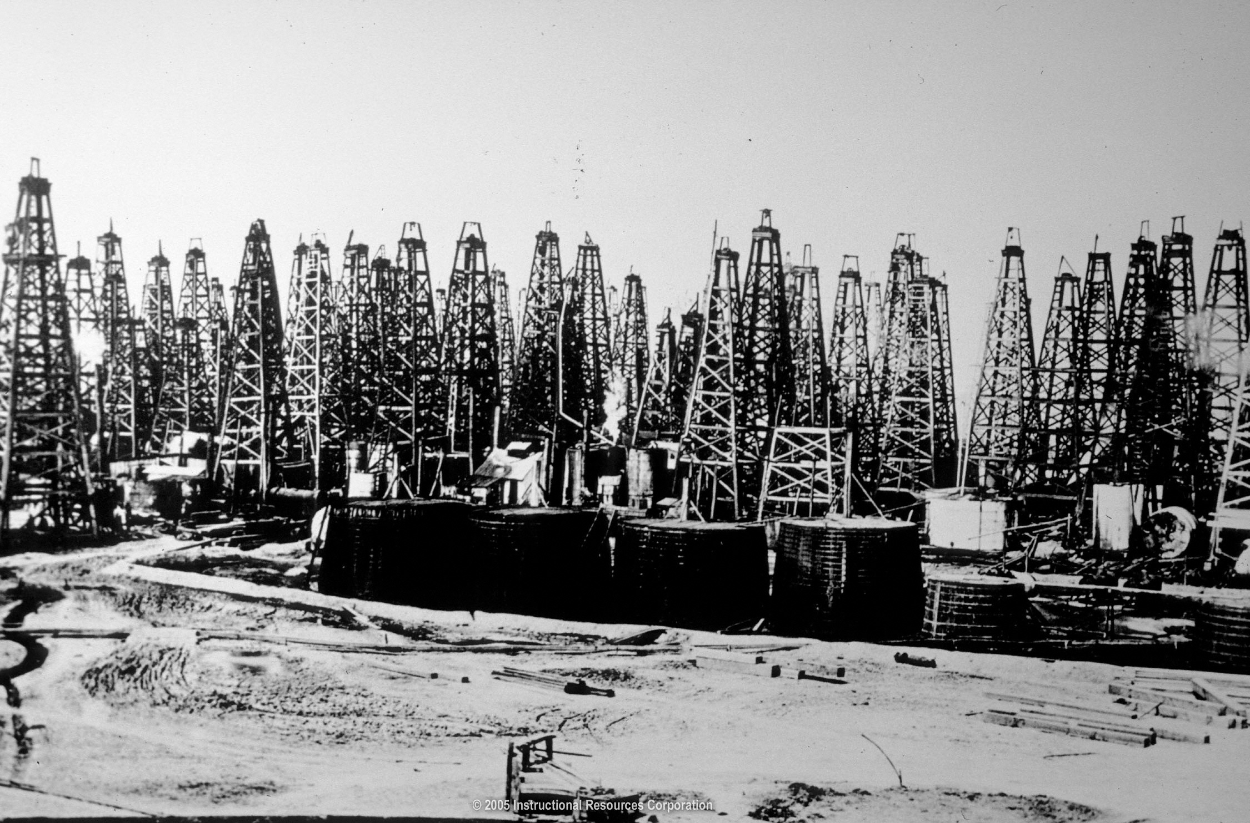
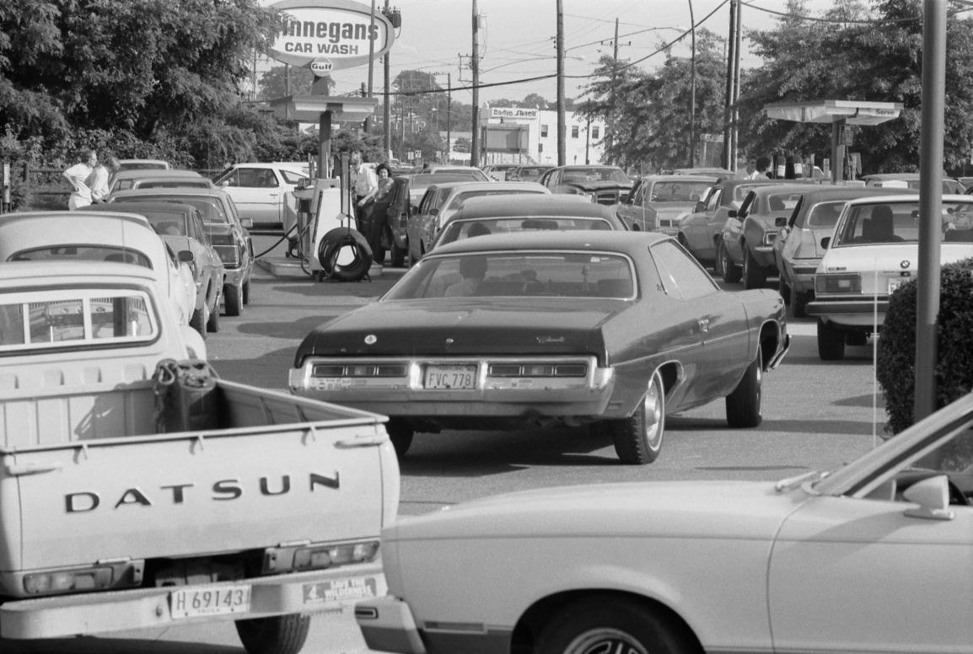
Baseline Oil: A Layman’s Survey
“It takes a lot of time and effort just to know what everybody else knows”
Notes:
Quote from Alex Berenson, “The Number”, pg.89
Image of Spindletop taken from http://www.cosmeo.com/viewPicture.cfm?guidImageId=B4CFE11E-5A42-434D-873C-D14D70602DAC&&nodeid=#
Image of Gas Lines inspired by Judith Stein, “Pivotal Decade”, and found at http://taleofthefishwife.files.wordpress.com/2008/06/line_at_a_gas_station_june_15_1979.jpg

Slide 2
Oil is the Biggest Business in the World
Taking all the companies that made more than $40B in revenue last year, and totaling those revenues according to industry sector, oil and gas was 27% bigger than all of finance combined (banking, financial services, and insurance):
Notes:
Data from http://en.wikipedia.org/wiki/List_of_companies_by_revenue

Slide 3
And it has been that way for decades…
Oil companies have occupied 203 out of the 570 slots in the Fortune 10 since the list was created 57 years ago, and Exxon is the only company to have appeared in every single list.
 | 1955 | 1956 | 1957 | 1958 | 1959 | 1960 | 1961 | 1962 | 1963 | 1964 | 1965 | 1966 | 1967 | 1968 | 1969 | 1970 | 1971 | 1972 | 1973 | 1974 | 1975 | 1976 | 1977 | 1978 | 1979 | 1980 | 1981 | 1982 | 1983 | 1984 | 1985 | 1986 | 1987 | 1988 | 1989 | 1990 | 1991 | 1992 | 1993 | 1994 | 1995 | 1996 | 1997 | 1998 | 1999 | 2000 | 2001 | 2002 | 2003 | 2004 | 2005 | 2006 | 2007 | 2008 | 2009 | 2010 | 2011
1 | GM | GM | GM | GM | GM | GM | GM | GM | GM | GM | GM | GM | GM | GM | GM | GM | GM | GM | GM | GM | Exxon | Exxon | Exxon | GM | GM | Exxon | Exxon | Exxon | Exxon | Exxon | Exxon | GM | GM | GM | GM | GM | GM | GM | GM | GM | GM | GM | GM | GM | GM | GM | Exxon | WalMart | WalMart | WalMart | WalMart | Exxon | WalMart | WalMart | Exxon | WalMart | WalMart
2 | Exxon | Exxon | Exxon | Exxon | Exxon | Exxon | Exxon | Exxon | Exxon | Exxon | Exxon | Ford | Ford | Exxon | Exxon | Exxon | Exxon | Exxon | Exxon | Exxon | GM | GM | GM | Exxon | Exxon | GM | Mobil | Mobil | GM | GM | GM | Exxon | Exxon | Exxon | Ford | Ford | Exxon | Exxon | Exxon | Ford | Ford | Ford | Ford | Ford | Ford | WalMart | WalMart | Exxon | GM | Exxon | Exxon | WalMart | Exxon | Exxon | WalMart | Exxon | Exxon
3 | US Steel | Ford | Ford | Ford | Ford | Ford | Ford | Ford | Ford | Ford | Ford | Exxon | Exxon | Ford | Ford | Ford | Ford | Ford | Ford | Ford | Ford | Texaco | Ford | Ford | Ford | Mobil | GM | GM | Mobil | Mobil | Mobil | Mobil | Ford | Ford | Exxon | Exxon | Ford | Ford | Ford | Exxon | Exxon | Exxon | Exxon | Exxon | WalMart | Exxon | GM | GM | Exxon | GM | GM | GM | GM | Chevron | Chevron | Chevron | Chevron
4 | GE | US Steel | US Steel | US Steel | GE | GE | GE | GE | GE | GE | GE | GE | GE | GE | GE | GE | GE | GE | GE | Chrysler | Texaco | Ford | Texaco | Mobil | Mobil | Ford | Texaco | Texaco | Texaco | Ford | Ford | Ford | IBM | IBM | IBM | IBM | IBM | IBM | IBM | IBM | WalMart | WalMart | WalMart | WalMart | Exxon | Ford | Ford | Ford | Ford | Ford | Ford | Chevron | Chevron | GM | ConocoPhillips | GE | ConocoPhillips
5 | Esmark | Chrysler | GE | GE | US Steel | US Steel | US Steel | Mobil | Mobil | Mobil | Mobil | Chrysler | Chrysler | Chrysler | Chrysler | IBM | IBM | IBM | Chrysler | GE | Mobil | Mobil | Mobil | Texaco | Texaco | Texaco | Chevron | Chevron | Ford | IBM | Texaco | IBM | Mobil | Mobil | GE | GE | Mobil | GE | GE | GE | AT&T | AT&T | GE | GE | GE | GE | GE | Enron | GE | GE | GE | Ford | ConocoPhillips | ConocoPhillips | GE | BofA | FNMA
6 | Chrysler | GE | Mobil | Chrysler | Mobil | Mobil | Mobil | US Steel | US Steel | US Steel | Chrysler | Mobil | Mobil | Mobil | IBM | Chrysler | Mobil | Mobil | IBM | Texaco | Chevron | Chevron | Chevron | Chevron | Chevron | Chevron | Ford | Ford | IBM | Texaco | IBM | Texaco | GE | GE | Mobil | Mobil | GE | Mobil | Mobil | Mobil | GE | IBM | IBM | IBM | IBM | IBM | Citigroup | GE | Citigroup | Chevron | Chevron | ConocoPhillips | GE | GE | GM | ConocoPhillips | GE
7 | Armour | Esmark | Chrysler | Mobil | Gulf Oil | Gulf Oil | Chrysler | Texaco | Texaco | Chrysler | US Steel | US Steel | Texaco | IBM | Mobil | Mobil | Chrysler | Chrysler | Mobil | Mobil | Gulf Oil | IBM | Gulf Oil | IBM | IBM | Gulf Oil | Gulf Oil | Amoco | Chevron | Dupont | Dupont | Chevron | AT&T | Texaco | Chrysler | Altria | Altria | Altria | Altria | Altria | IBM | GE | AT&T | Chrysler | Citigroup | Citigroup | Enron | Citigroup | Chevron | ConocoPhillips | ConocoPhillips | GE | Ford | Ford | Ford | AT&T | Berkshire
8 | Gulf Oil | Bethlehem | Esmark | Gulf Oil | Esmark | Texaco | Texaco | Gulf Oil | Gulf Oil | Texaco | Texaco | Texaco | US Steel | Texaco | Texaco | Texaco | ITT | Texaco | Texaco | IBM | GE | Gulf Oil | IBM | Gulf Oil | GE | IBM | IBM | IBM | Dupont | Amoco | AT&T | AT&T | Texaco | AT&T | Texaco | Chrysler | Texaco | Dupont | Chevron | Chrysler | Mobil | Mobil | Mobil | Mobil | Altria | AT&T | IBM | Chevron | IBM | Citigroup | Citigroup | Citigroup | Citigroup | Citigroup | AT&T | Ford | GM
9 | Mobil | Armour | AT&T | Bethlehem | Texaco | Chrysler | Gulf Oil | AT&T | AT&T | Gulf Oil | IBM | IBM | IBM | Gulf Oil | Gulf Oil | ITT | Texaco | ITT | ITT | ITT | IBM | GE | GE | GE | Gulf Oil | GE | Amoco | Gulf Oil | Gulf Oil | Chevron | GE | Dupont | Dupont | Dupont | Dupont | Dupont | Dupont | Texaco | Dupont | Texaco | Sears | Chrysler | Chrysler | Altria | Boeing | Altria | AT&T | IBM | AIG | IBM | AIG | AIG | BofA | BofA | HP | JPMorgan | BofA
10 | Dupont | Dupont | Gulf Oil | Esmark | AT&T | Esmark | AT&T | Esmark | Esmark | AT&T | Gulf Oil | Gulf Oil | Gulf Oil | US Steel | US Steel | Gulf Oil | AT&T | AT&T | AT&T | Gulf Oil | ITT | Chrysler | Chrysler | Chrysler | Chrysler | Amoco | GE | Arco | Amoco | GE | Amoco | GE | Chevron | Chrysler | Altria | Texaco | Chevron | Chevron | Texaco | Dupont | Altria | Altria | Altria | AT&T | AT&T | Boeing | Verizon | Altria | Verizon | AIG | IBM | IBM | AIG | AT&T | Valero | HP | Ford
Notes:
Fortune 500 from http://money.cnn.com/magazines/fortune/fortune500/2011/

Slide 4
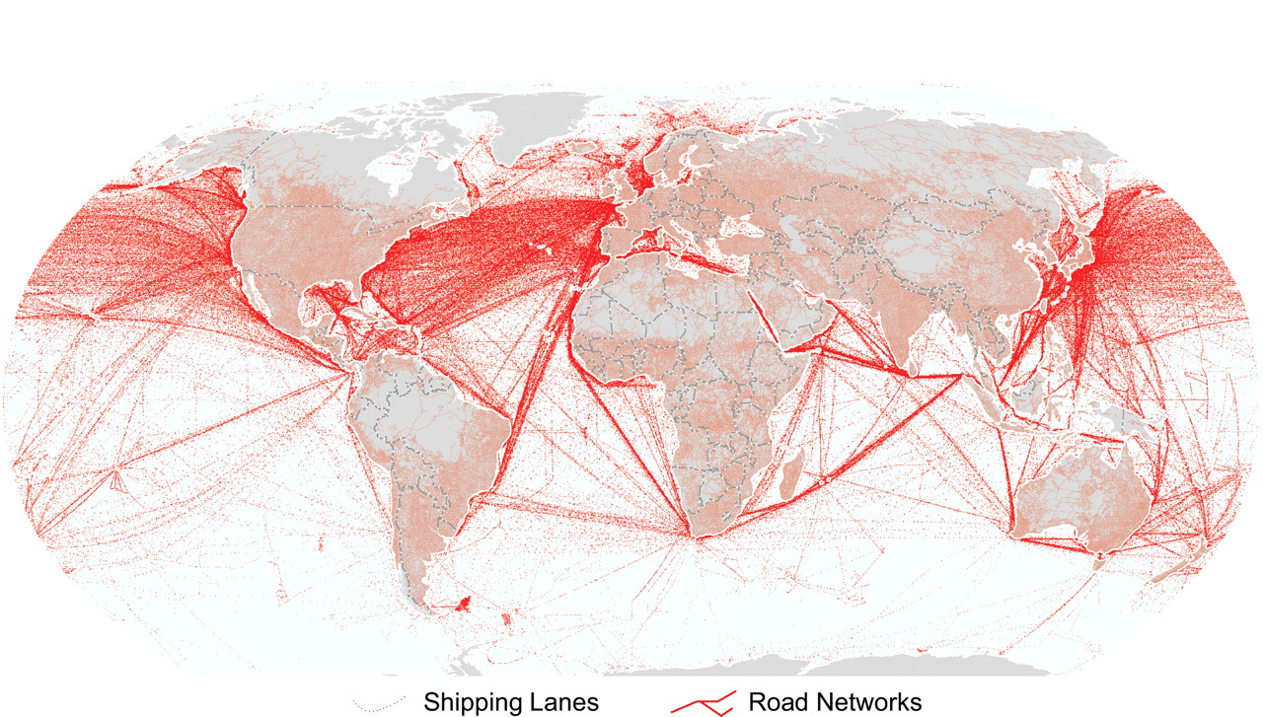
Oil and Transportation
Oil has many uses in industrial processes, electricity generation, and petrochemicals, but its heaviest use throughout the world is in transportation. More than 95% of vehicles on Earth run on oil products.
See Appendix A: Oil Statistics
Notes:
Image originally in Kareiva, P., et al. (2007) “Domesticated Nature: Shaping Landscapes and Ecosystems for Human Welfare.” Science 316, 1866. Retrieved from http://billjaquette.net/top-major-shipping-lanes-and-ports-in-the-world
95% of vehicles from http://www.popsci.com/technology/article/2011-06/last-drops-how-bridge-gap-between-oil-and-green-energy
Salmon anecdote from http://www.orionmagazine.org/index.php/articles/article/489/

Slide 5
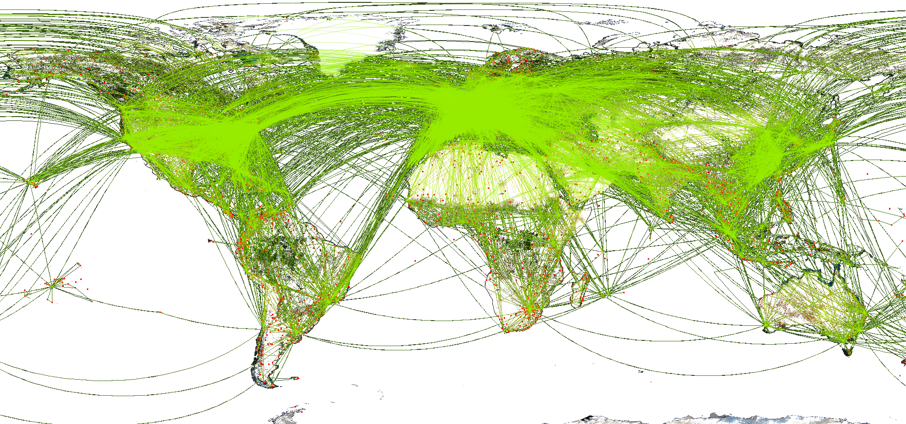
Oil and Transportation
Since oil is both a liquid at room temperature and relatively safe to handle, and since its energy content per weight is second only to nuclear power, oil is the only viable source of fuel for air travel. There have only been 11 major airplane crashes worldwide since 1939 due to fuel explosions, and only 3 since 1990.
World Air Routes
Notes:
http://en.wikipedia.org/wiki/File:World-airline-routemap-2009.png
Energy content per weight taken from http://www.aspousa.org/2010presentationfiles/10-8-2010_aspousa_PeakOilPicture_Skrebowski_C.pdf
Explosion data from http://planecrashinfo.com/cgi-bin/pssearch/search.cgi?search=0=1310817701=fuel%20explosion=and

Slide 6
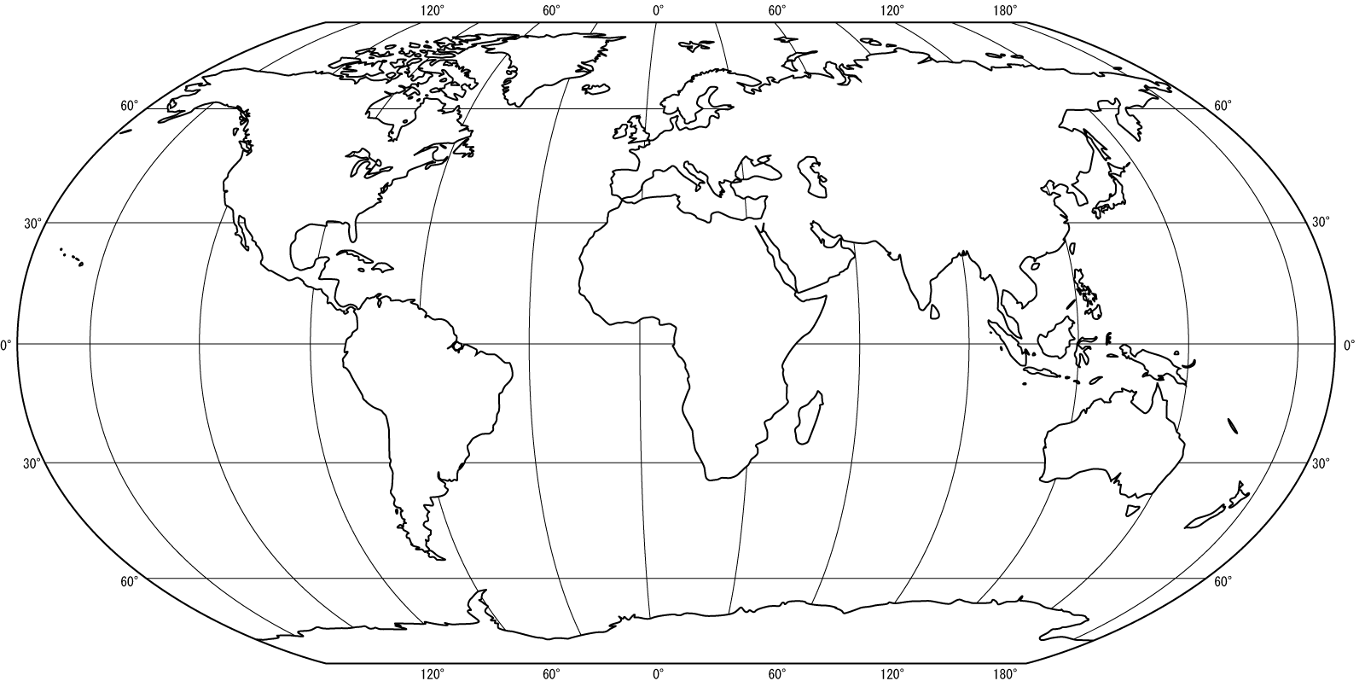
Oil and Geopolitics
As a result, the rising demand for oil and the security of its supply have dominated world politics for 40 years.
Canada
Europe
Former Soviet Union
USA
South Korea
Libya
Middle East
China
Mexico
Japan
Venezuela
Nigeria
India
Rest of
South and
Central America
Rest of Asia
Brazil
Rest of Africa
Australia
Worldwide
2010 Consumption 86.96 mbpd
See Appendix B: USCENTCOM
2010 Production 86.79 mbpd
Notes:
Map from http://mapsof.net/uploads/static-maps/world_map_outline.gif
2010 production data from http://www.eia.gov/cfapps/ipdbproject/iedindex3.cfm?tid=5&pid=53&aid=1&cid=regions&syid=2010&eyid=2010&unit=TBPD
2010 consumption data from http://www.eia.gov/cfapps/ipdbproject/iedindex3.cfm?tid=5&pid=5&aid=2&cid=regions&syid=2010&eyid=2010&unit=TBPD
Image inspired 1975 rendition found in Anthony Sampson, “The Seven Sisters: The Great Oil Companies and the World They Shaped”, the first page after the table of contents

Slide 7

Agenda
Oil Pricing
Breakdown
Short History
Financialization of Oil
Oil Demand
US Growth
World Growth
Oil Supply
Peak Oil Theory
Three reasons why it might be true
Four reasons why it might not
Impact of Plateau Oil
Past correlations of oil prices with UST10, UST 2-10 spread, and the S&P 500
Cost-push inflation
Sector balances
Hic Svnt Dracones
Medieval cartographers used to write “Here Be Dragons” at the edge of their maps.
The world is going into uncharted territory now with oil. Will we run into dragons?
Notes:
Image from http://www.tomorrowtoday.co.za/2011/05/16/here-there-be-dragons-hc-svnt-dracones-tbd/

Slide 8
Oil Pricing

Slide 9
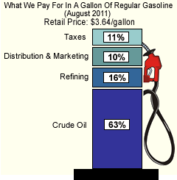

Oil Price Breakdown
When you buy gasoline from the pump, you’re paying for crude oil, taxes, marketing / distribution, and a small markup from the retail station owner.
The amount you pay varies dramatically from country to country. Here is a price breakdown for August 2011 gasoline in both the US and UK.
In the US, crude oil is usually more than 60% of the price of gas. In the UK, it is usually less than 40%. Taxes are the primary difference in price.
US ($3.64 / gallon) UK (132.9p / liter)
0.40
0.36
2.78
0.58
2.29
2.29
1.06
0.24
$3.64 / gal
$6.36 / gal
Notes:
Inspired by Morgan Downey, “Oil 101”, pg. 323

Slide 10
Oil Price Chain
Dealer Tank Wagon Price (DTW)– The wholesale price of oil delivered to retail outlets such as gasoline stations, i.e. what a gas station pays – they buy in full truck loads or 8,500 gallons.
Rack Price – The price of oil at a wholesale truck tanker terminal where delivery trucks load oil to bring to filling stations, homes, and offices.
Pipeline Price – The price of oil at a specified point in the pipeline.
Barge Price – The price of oil on a barge vessels usually on rivers or close to shore with a capacity typically between 8,000 and 50,000 bbls (some barges have more than 100,000 bbls capacity). Barge prices, because of additional handling costs, are higher than cargo prices.
Refinery Gate Price --- Price of crude oil going into a refinery.
Cargo Price – Price of crude oil on a large ocean-going tanker.
Wellhead Price – Price of oil at the wellhead.
Notes:
From Morgan Downey, “Oil 101”, pg. 322

Slide 11
Oil Price Discovery
All oil passes through a pipeline at some stage on its journey to the consumer
Pipelines are more efficient, reliable, and safe than truck or rail transport
Locations where pipelines meet are called hubs.
Hubs at ports are known as marine terminals.
As oil frequently changes hands at hubs and marine terminals, they are where modern price discovery occurs.
Notes:
From Morgan Downey, “Oil 101”, pg 257

Slide 12
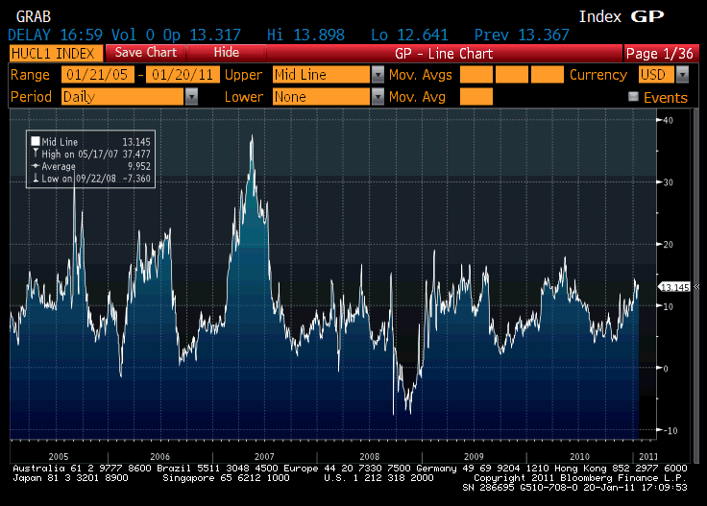
Oil Pricing – Crack Spreads
In addition to prices of crude oil, the price of a typical final product, such as jet fuel or gasoline, also incorporates a crack spread, which is the cost of refining. The crack spread is the difference in the price of a contract for gasoline and a contract for oil.
Notes:
Best explanation for the extreme crack spreads of 2007 can be found at ftp://ftp.eia.doe.gov/pub/oil_gas/petroleum/feature_articles/2008/spgmogas2008/spgmogas2008.pdf

Slide 13
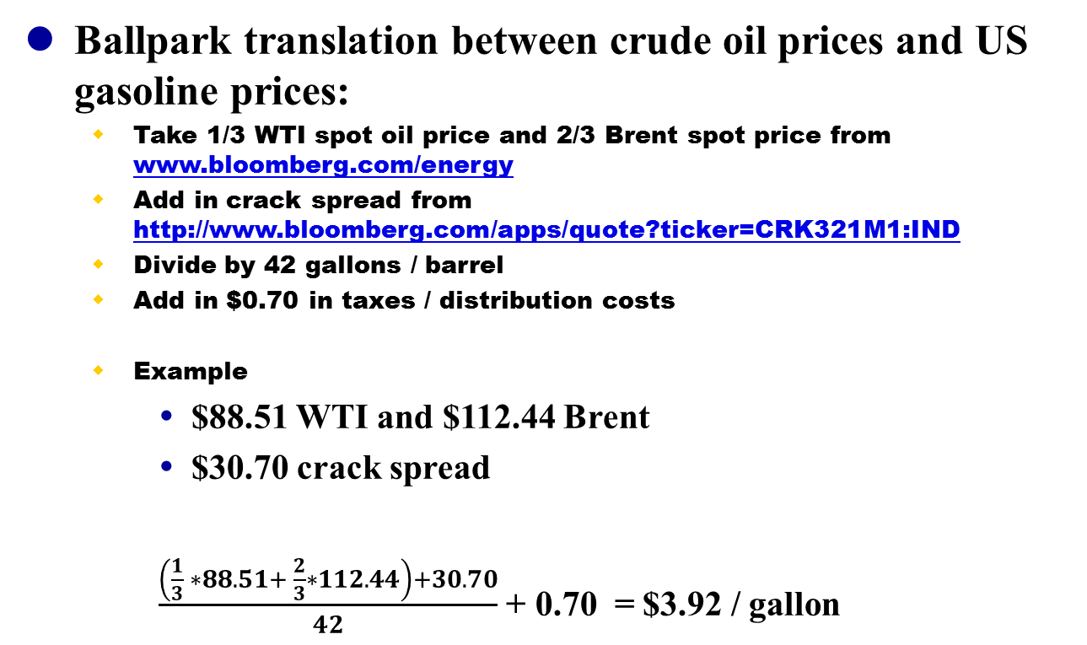
Oil Pricing – Putting it Back Together
Ballpark translation between crude oil prices and US gasoline prices:
Take 1/3 WTI spot oil price and 2/3 Brent spot price from www.bloomberg.com/energy
Add in crack spread from http://www.bloomberg.com/apps/quote?ticker=CRK321M1:IND
Divide by 42 gallons / barrel
Add in $0.70 in taxes / distribution costs
Example
$88.51 WTI and $112.44 Brent
$30.70 crack spread
$\frac{\left(\frac{1}{3} ∗88.51+ \frac{2}{3}∗112.44\right)+30.70}{42}$ + 0.70 = $3.92 / gallon

Slide 14
Oil Market History
From WWII until 1970, oil prices in the US Gulf Coast were set by the Texas Railroad Commission, and served as benchmark for the rolling concession agreements used by the integrated oil companies (IOCs) throughout the rest of the world.
Key points in the 1970s:
US oil production peaked in November 1970
US went off the gold standard in August 1971, and concurrently introduced oil price controls
Arab members of the Organization of Petroleum Exporting Countries (OPEC) embargoed oil to the US during the Yom Kippur War of 1973, kicking off the first oil crisis
Arab states either bought out the concessions, or nationalized oil facilities outright. This led to the rise of the national oil companies (NOCs), and greatly reduced the power of the IOCs
Iranian Revolution of 1979 and the taking of US hostages kicked off the second oil crisis
Cumulatively, these changes led to the end of the rolling concession agreements, and the rise of the spot market
Key points in the 1980s:
US price controls ended in 1981
New York Mercantile Exchange (NYMEX) launched futures contracts on West Texas Intermediate (WTI) light sweet crude oil in 1983
Saudi Arabia, in response to falling oil demand and rampant cheating on quotas by other OPEC members, started netback pricing scheme in 1985, which guaranteed a fixed profit to refiners. Refiners turned out as much product as possible to take advantage of fixed profit.
See Appendix C: Oil Price Structure History
Notes:
See Appendix C for sources

Slide 15
Oil Market – Where are We Now?
In 1988, netback pricing schemes changed to benchmark formulas:
Benchmark pricing references spot supply prices.
Five actively traded contracts. ~1/3 of the oil is priced to WTI, ~2/3 to Brent.
Over the counter (OTC) prices also tied to trade journals, primarily Platts Oilgram (owned by McGraw-Hill)
Formulas are used to take into account quality differences, taxes, destinations, etc.
Example:
Mexican Isthmus Crude = 0.4(WTS + LLS) + 0.2(Dated Brent) – constant
(where WTS (West Texas Sour), LLS (Light Louisiana Sweet), and Dated Brent are all published daily by Platts.)
With the rise of formulaic pricing based on front-month futures contracts, the worldwide price of oil is now dependent upon marginal demand for the next available barrel.
NYMEX (New York) Futures | Ticker | ICE (London) Futures |  |  | Ticker
WTI Crude Oil (1000 bbls) | CL | Brent Crude (1000 bbl) |  |  | CO
Heating Oil (42000 gallons) | HO | Gasoil (100 metric tonnes) |  |  | QS
Gasoline (42000 gallons) | RB
Notes:
1988 benchmark schemes comes from http://www.eia.doe.gov/cabs/AOMC/8089.html
Benchmark pricing referencing spot prices comes from Morgan Downey “Oil 101” pg. 318
1/3 oil prices from WTI 2/3 from Brent comes from Morgan Downey, “Oil 101” pg. 355
Futures contracts comes from Morgan Downey, “Oil 101” pg. 332
Trade journal pricing comes from Morgan Downey, “Oil 101” pg. 318-9
Example comes from Morgan Downey, “Oil 101” pg. 321

Slide 16
Oil Market – The Financialization of Oil
Key points in the 1990s:
Goldman Sachs exempted from position limits as a Bona Fide Hedger in October, 1991
Sets up investable Goldman Sachs Commodity Index
Prudent Investor Act replaces Prudent Man Act in August of 1994
Emphasizes diversification and relaxes restrictions on institutional investors.
Commodity Futures Trading Commission (CFTC) grants exemption for International Petroleum Exchange (IPE) in November, 1999. The exchange is regulated under UK Law.
Key points in the 2000s:
Commodities Future Modernization Act is passed in December of 2000, granting exemptions to regulation for electronic OTC platforms
Intercontinental Exchange (ICE) founded in May of 2000, with backing from major investment banks
Creates electronic OTC platform for oil, and buys IPE; operates under two exemptions.
CFTC relaxes restrictions on institutional investors regarding position limits in August 2003
Enormous changes result to benchmark oil markets:
WTI market grows from $11.6B to $115.0B in 2011 in real dollars
Speculative long positions grow from 9% to 48%, while commercial long positions fall from 60% to 32%.
Real oil prices have become increasingly volatile
Oil increases its correlation with S&P 500
Saudi Arabia ends the use of WTI in pricing its crude oil.
See Appendix D: The Financialization of Oil
Notes:
See Appendix D for sources

Slide 17
Oil Market – Where are We Now?
Oil is traded in US dollars.
Oil is itself a currency
If US dollar weakens against oil consumption currencies, ceteris paribus, oil prices will rally in dollar terms and vice-versa
Four basic reasons oil is traded in dollars:
US dollar is most freely convertible and liquid currency in the world
Single currency trading allows for more efficient arbitrage
Oil traders don’t have to worry about currency exchange risk
Oil producers not wanting US dollars can convert into whatever currency they want immediately.
This gives the US enormous advantages:
Allows the US to run a current account deficit with less inflation
Countries need to keep dollars on hand to purchase oil and not recycle them back into the US economy.
US effectively enjoys seigniorage with respect to all oil transactions.
Money the Fed creates can be used to buy oil without needing to produce corresponding goods and services.
Other countries need to produce goods and services, ultimately priced in dollars, before being able to purchase oil.
Notes:
First two data points comes from Morgan Downey “Oil 101” pg. 323
Second two points comes from Kent Moors, “The Vega Factor”, pg. 69, and from David Spiro, “The Hidden Hand of American Hegemony”, pg. 121

Slide 18
Modern Oil Market
Since oil is a fungible commodity, the result of these historical changes in its supply and pricing has been to create a fully global yet remarkably homogeneous market.
Although simplistic, a good mental model for the modern oil market is a trough where every day, exporters pour oil in from their own cup (resources), and importers draw it out from their cup (needs).
Furthermore, oil has one price, in one currency, determined in real time by exchange markets.
The security of the market lies solely in the diversity of its supplies.
Exporters dumping oil in
United Arab Emirates
24 Other Exporters
Saudi Arabia
Iraq
Kazakhstan
Libya
Canada
NIgeria
Qatar
Kuwait
Angola
Russia
Iran
Algeria
Norway
Venezuela
Market coming to a price based on formulas that use futures markets to gauge marginal demand for next available barrel
2010 Transnational Oil Market: Exports – 44.1 mbpd; Imports – 44.3 mbpd
Japan
France
Netherlands
Germany
India
Spain
Italy
Taiwan
Thailand
Belgium
United States
China
South Korea
Singapore
Turkey
163 Other Importers
Importers drawing it out
Notes:
2010 production data from http://www.eia.gov/cfapps/ipdbproject/iedindex3.cfm?tid=5&pid=53&aid=1&cid=regions&syid=2010&eyid=2010&unit=TBPD
2010 consumption data from http://www.eia.gov/cfapps/ipdbproject/iedindex3.cfm?tid=5&pid=5&aid=2&cid=regions&syid=2010&eyid=2010&unit=TBPD
Trough model inspired by Fred Singer, http://www.washingtontimes.com/news/2003/nov/26/20031126-075005-4180r/print/, and Robert Bryce, “Gusher of Lies”, pg. 70

Slide 19
Oil Demand

Slide 20
Oil and the US Economy
Between 1949 and 1973, cheap and stable oil (avg $22.7/bbl in 2010 dollars) drove a dramatic per-capita increase in oil consumption within the US:
Notes:
Oil consumption 1949-1972 http://www.eia.gov/totalenergy/data/annual/xls/stb0103.xls (note that BTU had to be converted to kbpd using http://www.eia.doe.gov/kids/energy.cfm?page=about_energy_conversion_calculator-basics)
Oil consumption 1973-2010 http://www.eia.gov/dnav/pet/hist/LeafHandler.ashx?n=PET&s=MTTUPUS2&f=A
US Population http://www.eia.gov/totalenergy/data/annual/showtext.cfm?t=ptb1501
Real oil prices from http://www.inflationdata.com/inflation/inflation_rate/historical_oil_prices_table.asp

Slide 21
Oil and the US Economy
And cheap and stable oil transformed the way we lived:
Number of motor vehicles in the US grows from 45M in 1949 to 119M in 1972.
In 1956, Dwight Eisenhower signs the Interstate Highway Bill, authorizing the creation of 41,000 miles of superhighways.
Between 1950 and 1976, Americans living in cities increases by 10M; Americans living in suburbs increases by 85M.
In 1954, Ray Kroc teams up with the McDonald brothers to found McDonald’s restaurants.
In 1946, there were 8 shopping centers in the US; by the 1980s, there are over 20,000.
In 1958, the Boeing 707 ushers in the Jet Age with its inaugural flight for Pan American World Airways.
Notes:
Daniel Yergin, “The Prize”, pg. 524, 533-535.
Last bullet point from http://en.wikipedia.org/wiki/Boeing_707

Slide 22
US Economic Efficiency
In 1979 the average American burned 30.02 barrels of oil to create $26,010.66 in real GDP. In 2010, the average American burned 22.65 barrels of oil to create $42,860.56 in real GDP. Real American wealth has been increasing, even as oil consumption has remained flat.
Notes:
Oil consumption 1949-1972 http://www.eia.gov/totalenergy/data/annual/xls/stb0103.xls (note that BTU had to be converted to kbpd using http://www.eia.doe.gov/kids/energy.cfm?page=about_energy_conversion_calculator-basics)
Oil consumption 1973-2010 http://www.eia.gov/dnav/pet/hist/LeafHandler.ashx?n=PET&s=MTTUPUS2&f=A
US GDP and population http://www.eia.gov/totalenergy/data/annual/showtext.cfm?t=ptb1501

Slide 23
Oil and the US Economy
As the population of the US has grown, so has the total amount of oil consumed:
In 2010, the US population is 2.07x bigger but consumes 3.41x more oil than in 1949. (And in 2005 the US was at 1.98x and 3.71x, respectively.)
Notes:
Oil consumption 1949-1972 http://www.eia.gov/totalenergy/data/annual/xls/stb0103.xls (note that BTU had to be converted to kbpd using http://www.eia.doe.gov/kids/energy.cfm?page=about_energy_conversion_calculator-basics)
Oil consumption 1973-2010 http://www.eia.gov/dnav/pet/hist/LeafHandler.ashx?n=PET&s=MTTUPUS2&f=A
US Population http://www.eia.gov/totalenergy/data/annual/showtext.cfm?t=ptb1501

Slide 24
Oil and the US Economy
Since its production peaked back in 1970, the US has imported more than 115 billion barrels of oil to meet its growing energy needs.
See Appendix E: US Petroleum Flows
Notes:
Oil consumption 1949-1972 http://www.eia.gov/totalenergy/data/annual/xls/stb0103.xls (note that BTU had to be converted to kbpd using http://www.eia.doe.gov/kids/energy.cfm?page=about_energy_conversion_calculator-basics)
Oil consumption 1973-2010 http://www.eia.gov/dnav/pet/hist/LeafHandler.ashx?n=PET&s=MTTUPUS2&f=A
Domestic production http://www.eia.gov/dnav/pet/hist/LeafHandler.ashx?n=PET&s=MCRFPUS2&f=A
Imports 1949-1972 http://www.eia.gov/totalenergy/data/annual/xls/stb0101.xls (note that BTU had to be converted to thousands of bpd using http://www.eia.doe.gov/kids/energy.cfm?page=about_energy_conversion_calculator-basics)
Imports 1973-2010 http://www.eia.gov/dnav/pet/hist/LeafHandler.ashx?n=pet&s=mttntus2&f=a
Residuals calculated as the difference between consumption and (productions plus imports)

Slide 25
Oil and the World Economies
As the world economy has grown over the last 31 years, so has its consumption of oil:
Notes:
World real gdp data from http://databank.worldbank.org/ddp/home.do?Step=2&id=4&DisplayAggregation=N&SdmxSupported=Y&CNO=2&SET_BRANDING=YES
World oil consumption from 1980 through 2010 taken from http://www.eia.gov/cfapps/ipdbproject/iedindex3.cfm?tid=5&pid=5&aid=2&cid=regions&syid=1980&eyid=2010&unit=TBPD

Slide 26
Oil and the World Economies
In the past 31 years, real income in the developed world has grown 107.8%, as measured by the countries in the Organization for Economic Cooperation and Development (OECD); in the developing world, 264.2%.
India’s income has grown 516.5%; China’s has grown 1672.7%. Since being admitted to the World Trade Organization in December, 2001, China’s income has grown 149.9%
Notes:
World real gdp data from http://databank.worldbank.org/ddp/home.do

Slide 27
Oil and the World Economies
In the past 31 years, worldwide oil consumption in the developed world has grown 11.6%; in the developing world, 89.0%.
China and India’s oil usage has grown 413.7% in the past 31 years. The BRIC countries in general have increased oil usage by 53.2%. OPEC itself has increased its consumption (and cannibalized its exports) by 221%.
Notes:
All data from http://tonto.eia.doe.gov/cfapps/ipdbproject/iedindex3.cfm?tid=5&pid=5&aid=2&cid=regions&syid=1980&eyid=2010&unit=TBPD
“Rest of OECD” is Australia, Austria, Belgium, Canada, Chile, Czech Republic, Slovakia, Denmark, Estonia, Finland, France, Germany, Greece, Hungary, Iceland, Ireland, Israel, Italy, Japan, South Korea, Luxembourg, Mexico, Netherlands, New Zealand, Norway, Poland, Portugal, Slovenia, Spain, Sweden, Switzerland, Turkey, United Kingdom
OPEC nations are Algeria, Angola, Ecuador, Iran, Iraq, Kuwait, Libya, Nigeria, Qatar, Saudi Arabia, United Arab Emirates, Venezuela, Gabon, and Indonesia. Note Indonesia became an oil importer in 2008 and dropped out of OPEC. Gabon dropped out in 1995 because it didn’t want to pay OPEC dues.

Slide 28
Oil and the World Economies
Since 1980, the US and the rest of the OECD have increased their per-capita economies by 67% and 61%, in turn, while their per-capita oil consumption has been flat, with their standard deviations being less than 4% and 6% of their mean values, respectively.
Notes:
Population and real GDP data from http://databank.worldbank.org/ddp/home.do
Oil from http://tonto.eia.doe.gov/cfapps/ipdbproject/iedindex3.cfm?tid=5&pid=5&aid=2&cid=regions&syid=1980&eyid=2010&unit=TBPD
“Rest of OECD” is Australia, Austria, Belgium, Canada, Chile, Czech Republic, Slovakia, Denmark, Estonia, Finland, France, Germany, Greece, Hungary, Iceland, Ireland, Israel, Italy, Japan, South Korea, Luxembourg, Mexico, Netherlands, New Zealand, Norway, Poland, Portugal, Slovenia, Spain, Sweden, Switzerland, Turkey, United Kingdom

Slide 29
Oil and the World Economies
For all the marginal impact the Chinese and Indian economies have had on the world economy and its oil consumption, on a per-capita basis they are both just really getting started:
Notes:
Population and real GDP data from http://databank.worldbank.org/ddp/home.do
Oil from http://tonto.eia.doe.gov/cfapps/ipdbproject/iedindex3.cfm?tid=5&pid=5&aid=2&cid=regions&syid=1980&eyid=2010&unit=TBPD

Slide 30
Oil and the World Economies
In the past 11 years, car and truck production from the US, Japan, Germany, South Korea and France has fallen 14.0%; elsewhere, it has grown 76.9%.
Chinese and Indian vehicle production has grown 723.3% since 1999. China produced the most in the world in 2009 and 2010, and in 2010 China’s total production of 18,264,667 was greater than the combined output of #2 producer Japan at 9,625,940 and #3 producer USA at 7,761,443.
Notes:
All data from http://oica.net/category/production-statistics/

Slide 31
Oil and the World Economies
Outliers
High GDP / High Density Countries
High GDP / Low Density Countries
Emerging Economies
Notes:
Population from http://data.worldbank.org/indicator/SP.POP.TOTL
Oil from http://www.eia.gov/cfapps/ipdbproject/iedindex3.cfm?tid=5&pid=5&aid=2&cid=regions&syid=2010&eyid=2010&unit=TBPD
GDP from http://data.worldbank.org/indicator/NY.GDP.MKTP.CD, except Australia, which comes from the avg of the CIA World Factbook estimate and the IMF estimate, as found on http://en.wikipedia.org/wiki/List_of_countries_by_GDP_(nominal)
Area from http://data.worldbank.org/indicator/AG.LND.TOTL.K2
Graph inspired by Morgan Downey, “Oil 101”, pg. 18

Slide 32
Oil and the World Economies
Taking the high, low, and average per-capita barrels consumed over the past 30 years for the US and the rest of the OECD, and projecting their respective populations in 2020, we can get a high, low, and average demand scenario for the developed world.
Taking population and per-capita oil consumption growth rates for China, India, and the rest of the world over the past 10-, 7-, and 3-year timeframes, we can get respective 2020 projections for the developing world.
Summing the highs and lows from each scenario gives us a range of 2020 world oil demand:
With our current consumption at 87,068 kbpd, can the world supply even the smallest of these potential demand targets?
 | Developed World |  |  |  |  | Developing World
 | US | Rest of OECD | Total |  |  | China | India | Rest of World | Total
High | 24,158.98 | 32,865.79 | 57,024.76 |  | 10 yr rates | 17,169.53 | 4,636.62 | 35,948.44 | 57,754.59
Avg | 23,102.08 | 30,597.60 | 53,699.68 |  | 7 yr rates | 15,277.66 | 4,678.16 | 35,660.16 | 55,615.99
Low | 20,894.76 | 27,307.06 | 48,201.81 |  | 3 yr rates | 15,752.96 | 4,095.38 | 34,361.21 | 54,209.55
 | daily oil consumption (kbpd) |  |  |  |  | daily oil consumption (kbpd)
2020 World Demand Scenario
High | 114,779.35 kbpd
Low | 102,411.36 kbpd

Slide 33
Oil Supply

Slide 34
Peak Oil
Peak Oil is a very controversial theory that stipulates:
There is a peak amount of oil that can be produced given the world’s reserves
The world is now either near, at, or even past this peak production.
Peak Oil invokes lots of shrill, ad hominem attacks between the cornucopians and the doomers, aka “The Economists” and “The Geologists.”
There are at least three reasons to believe Peak Oil
Lack of discoveries of huge new oil fields
Rapid depletion of existing oil fields versus expected oil coming on-stream
Hubbert’s Peak
There are at least four reasons to NOT believe Peak Oil
Historical precedence
Reserves growth / backdating of existing discoveries
Depletion mitigation through investment in enhanced oil recovery (EOR) techniques.
Significant model and data problems with Hubbert’s Peak

Slide 35
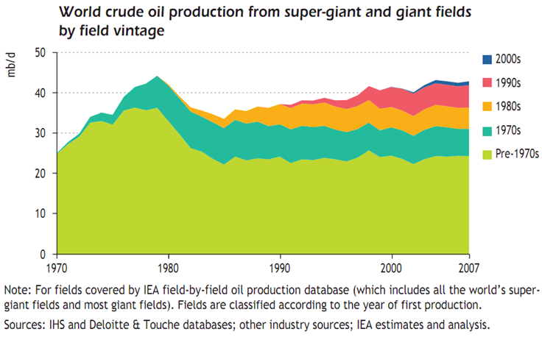
Peak Oil Reason #1: Lack of New Discoveries
The world produces ~74 million barrels per day in crude oil, and ~12 million barrels per day in other liquids and in processing gain. As this graph from the International Energy Agency (IEA) shows, about half that crude oil is still being pumped from large fields discovered before 1990:
See Appendix F: Lack of New Discoveries
Notes:
From http://www.iea.org/textbase/nppdf/free/2008/weo2008.pdf, pg. 227

Slide 36
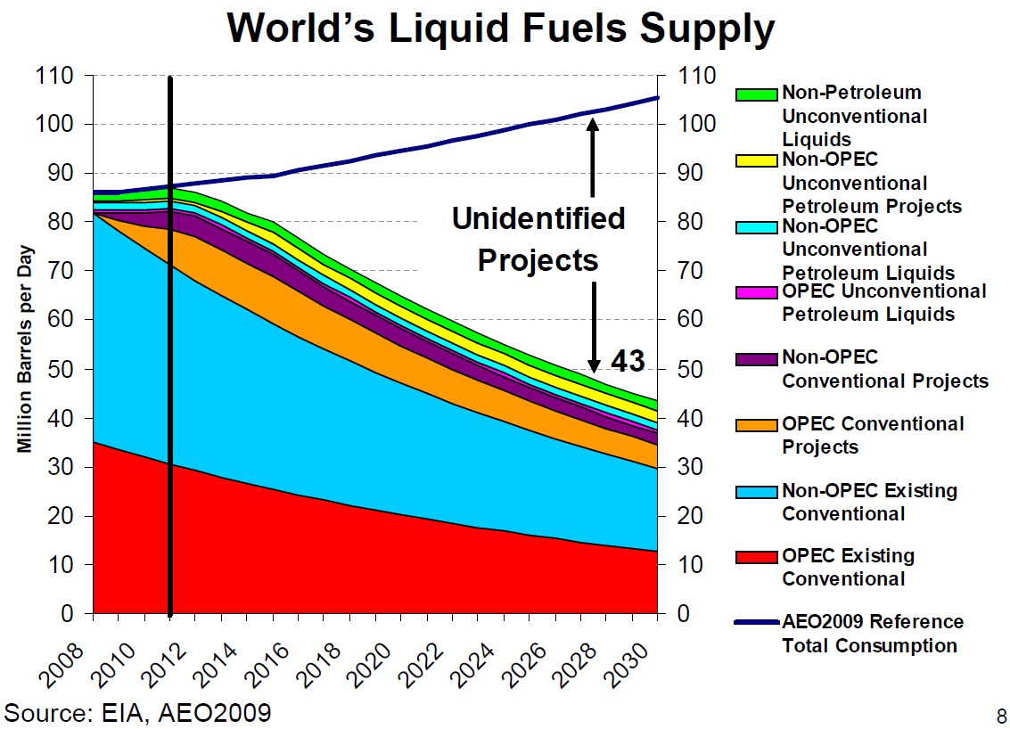
Peak Oil Reason #2: Ongoing Depletion v. New Supplies
Furthermore, according to the IEA, the world’s existing oil fields are depleting at an annual rate of 6.7%, or 4.96 mbpd production. New projects, not yet publicly identified, will have to be brought on-stream simply to maintain 2011 production levels:
The IEA anticipates that $8.4T will have to be invested in the oil and gas sectors, between 2007-2030, in order for the world to meet its demand projections (2007 dollars).
See Appendix G: Depletion v. New Supply
Notes:
http://www.eia.gov/conference/2009/session3/Sweetnam.pdf
Second bullet point from http://www.iea.org/textbase/nppdf/free/2008/weo2008.pdf, pg. 323

Slide 37
Peak Oil Reason #3: Hubbert’s Peak
The Peak Oil concept was originally developed by a Shell Oil geophysicist named M. King Hubbert – hence its often known as Hubbert’s Peak.
In 1956, Hubbert used the model to correctly predict that US oil would peak in the early 1970s.
When the Peak Oil model is applied to worldwide production, it indicates that the global supply of oil peaked sometime around 2005/6, and that the available oil supply will begin to taper off.
See Appendix H: Hubbert’s Peak
Notes:
The entire Peak Oil explication is taken wholesale from Ken Deffeyes, “Beyond Oil”, pg. 35-51.
World oil production from 1960 until 1972 taken solely from http://www.eia.doe.gov/emeu/aer/txt/stb1105.xls
World oil production from 1973 until 1979 sum of above data plus NGL data from http://www.eia.doe.gov/emeu/aer/txt/stb1106.xls
In the interest of consistency with the rest of the presentation, world oil production data from 1980 to 2009 taken from http://tonto.eia.doe.gov/cfapps/ipdbproject/iedindex3.cfm?tid=5&pid=53&aid=1&cid=regions&syid=1980&eyid=2010&unit=TBPD

Slide 38
Anti-Peak Oil Reason #1: Historical Problems
This is at least the 5th time that “the world is running out of oil”
End of Pennsylvania discoveries (1879 on):
In 1885, the State Geologist of Pennsylvania warned that “the amazing exhibition of oil…[was only] a temporary and vanishing phenomenon – one in which young men will live to see come to its natural end.”
John Archbold of Standard Oil on discoveries in Oklahoma: “Are you crazy? Why I’ll drink every gallon produced west of the Mississippi”
Spindletop discovered in 1901
Post WWI:
In 1919, the director of the US Bureau of Mines predicted that “within the next two to five years, the oil fields in [the US] will reach their maximum production, and from that time on we will face an ever increasing decline”
In 1924, Harry Doherty, CEO of Cities Service (aka Citgo) – “If the public some day in the near future awakens to the fact that we have become a bankrupt nation as far as oil is concerned, and that it is then too late to protect our supply conservation measures, I am sure they will blame both the men of the oil industry and the men who held public offices at the time conservation measures should have been adopted”
East Texas ‘Black Giant’ discovered in 1930
Post WWII:
The director of reserves for the Petroleum Administration for War in 1943: “The law of diminishing returns is becoming operative. As new oil fields are not being formed and as the number is ultimately finite, the time will come sooner or later when the supply is exhausted.”
James Forrestal in 1945: “If we ever got into another World War it is quite possible that we would not have access to reserves held in the Middle East but in the meantime the use of those reserves would prevent the depletion of our own, a depletion which may be serious within the next 15 years.”
Ghawar discovered in Saudi Arabia in 1948
1970s Oil Crisis:
In 1973, US State Department official (later ambassador to Saudi Arabia) James Akins publishes, in Foreign Affairs, a famous article named “The Oil Crisis: This Time, the Wolf is Here”
North Sea, Prudhoe Bay, and Cantarell oilfields came on line in 1975, 1977, and 1981, and demand destruction took hold
Notes:
All quotes from Daniel Yergin, “The Prize”
Quotes in first two bullets from page 36
Post WWI quotes from pages 178 and 204
Post WWII quotes from pages 377 and 389
Akins article can be read at http://www-personal.umich.edu/~twod/oil-ns/articles/for_aff_aikins_oil_crisis_apr1973.pdf

Slide 39
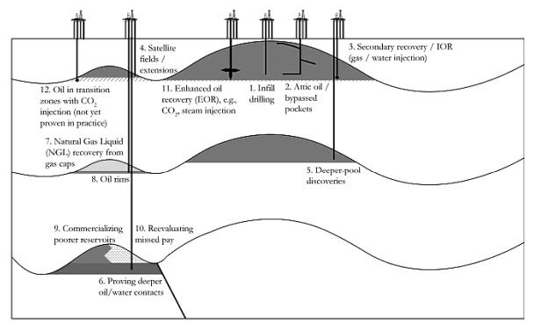
Anti-Peak Oil Reason #2: Reserves Growth
Oil Reserves can grow, even for existing fields, as the IOCs and NOCs better understand the geological formations. But new additions, like the 12 hypothetical plays shown below, are backdated to when the field was first discovered.
There are a number of economic reasons for IOCs and NOCs to spend money examining current findings first, before embarking on new explorations.
Any new oil can use existing infrastructure (gas-oil separation plants, water processing, and pipeline).
Any oil that is found will be highly likely to meet commercial standards.
See Appendix I: Reserves Growth
Notes:
Diagram comes from Robin Mills, “The Myth of the Oil Crisis”, pg. 80

Slide 40
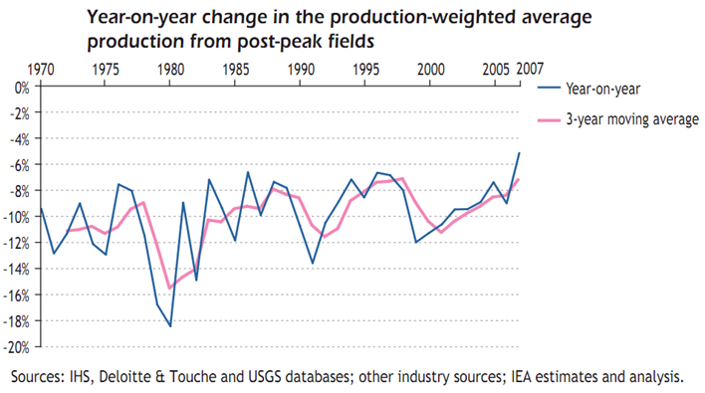
Anti-Peak Oil Reason #3: Depletion Mitigation
Capital investment in production maintenance and enhanced oil recovery (EOR) techniques can slow depletion.
While the 2008 IEA study estimated worldwide depletion to be 6.7%, it determined that the natural depletion rate – i.e. depletion absent investment – would have been 9%.
Thus the depletion rate itself is not static:
Notes:
First bullet point from http://www.iea.org/textbase/nppdf/free/2008/weo2008.pdf, pg. 244
Second bullet point (graph) from http://www.iea.org/textbase/nppdf/free/2008/weo2008.pdf, pg. 242

Slide 41
Anti-Peak Oil Reason #4: Model Problems
Hubbert correctly predicted the timeframe for the peaking of US oil production. However, the model does a very poor job of explaining the downward slope of the production curve, as more EOR techniques are used
Below are 4 different applications of Hubbert’s Peak: one against the US production data in 1956 (the year Hubbert made the prediction), 1970 (the year US oil production peaked), and two backwards looking predictions, one for the entire set and one for just the last 30 years.
None of the 4 curves do a particularly good job in modeling true US oil production:
See Appendix J: Model Problems
See Appendix K: Data Problems
Notes:
The concept behind this explanation of Peak Oil is taken wholesale from Ken Deffeyes, “Beyond Oil”, pg. 35-51.
US oil production data taken from http://tonto.eia.doe.gov/dnav/pet/hist/LeafHandler.ashx?n=PET&s=MCRFPUS2&f=A

Slide 42
Peak Oil – So Where are We?
Peak Oil does not seem to properly take reserves growth into account
Hubbert’s Peak Oil Model has problems, particularly with the way it describes post-peak production
Still, the depletion rate of existing oil fields is requiring the replacement of at least 4.96 mbpd every year in production, and the world will likely have to invest ~$8.4T in the oil and gas sectors before 2030
There have NOT been any new huge, Ghawar-like finds in 40 years, despite 3D seismic imaging and the exponential growth of computational power.
World oil production has only grown fractionally since 2004, despite persistently rising prices:
Notes:
World oil production from 1960 until 1972 taken solely from http://www.eia.doe.gov/emeu/aer/txt/stb1105.xls
World oil production from 1973 until 1979 sum of above data plus NGL data from http://www.eia.doe.gov/emeu/aer/txt/stb1106.xls
In the interest of consistency with the rest of the presentation, world oil production data from 1980 to 2010 taken from http://tonto.eia.doe.gov/cfapps/ipdbproject/iedindex3.cfm?tid=5&pid=53&aid=1&cid=regions&syid=1980&eyid=2010&unit=TBPD
Oil prices from http://www.inflationdata.com/inflation/inflation_rate/historical_oil_prices_table.asp

Slide 43
Peak Oil – So Where are We?
In the case of the US, the Hubbert models all did a reasonable job of describing rising production, albeit with some errors. The model generated with 1956 data was 5 years early, and 27.3% too pessimistic. The model generated with 1970 data was 3 years too late, and 13.5% too pessimistic.
If we assume the Hubbert model for world production is similarly flawed, then the real peaking will likely occur shortly after 2011 (if it hasn’t happened already), and real peak production will be somewhere between 91.6 mbpd and 102.8 mbpd.
Notes:
The entire Peak Oil explication is taken wholesale from Ken Deffeyes, “Beyond Oil”, pg. 35-51.
US oil production data taken from http://tonto.eia.doe.gov/dnav/pet/hist/LeafHandler.ashx?n=PET&s=MCRFPUS2&f=A
World oil production from 1960 until 1972 taken solely from http://www.eia.doe.gov/emeu/aer/txt/stb1105.xls
World oil production from 1973 until 1979 sum of above data plus NGL data from http://www.eia.doe.gov/emeu/aer/txt/stb1106.xls
In the interest of consistency with the rest of the presentation, world oil production data from 1980 to 2009 taken from http://tonto.eia.doe.gov/cfapps/ipdbproject/iedindex3.cfm?tid=5&pid=53&aid=1&cid=regions&syid=1980&eyid=2010&unit=TBPD

Slide 44
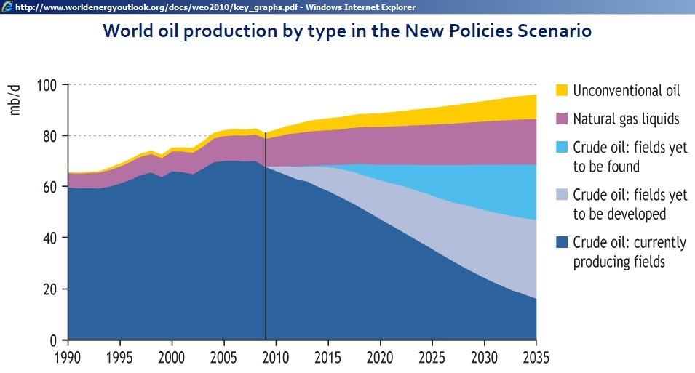
Peak Oil – So Where are We?
My belief is that world oil production will not fall off as precipitously as Hubbert’s Peak Oil Model implies, but that it has reached a plateau. Some years will see a temporary boost in production due to successful EOR projects, but downward pressure due to depletion will never again allow the world to grow its supply significantly.
The IEA is more optimistic than I am. According to the IEA, conventional crude oil production peaked in 2005. But new sources, including an increase in NGLs and unconventional oil sources (e.g. tar sands, XtL, etc.), will allow the world oil supply to continually grow, albeit more slowly than in the past.
See Appendix L: Undulating Plateau
Notes:
From http://www.worldenergyoutlook.org/docs/weo2010/key_graphs.pdf

Slide 45
Peak Oil – So Where are We?
Even so, the IEA’s reference scenario projections, published biannually, have become noticeably less optimistic over the last 10 years:
See Appendix N: Harbinger of the End
Notes:
2010 data from http://www.worldenergyoutlook.org/docs/weo2010/key_graphs.pdf (all data except the last point had to be interpreted from the graph)
2008 data from http://www.iea.org/textbase/nppdf/free/2008/weo2008.pdf, pg. 251
2006 data from http://www.iea.org/textbase/nppdf/free/2006/weo2006.pdf, pg. 93
2004 data from http://www.iea.org/textbase/nppdf/free/2004/weo2004.pdf, pg. 106
2002 data from http://www.iea.org/textbase/nppdf/free/2000/weo2002.pdf, pg. 96

Slide 46
Impact of Plateau Oil
For the first time in history, people are scared that there may be more demand for barrels of oil, every day, than can be produced. Reserves are going down, oil fields are producing less. That isn’t changing. We’re gradually reaching that scary equilibrium. And in July of 2008, we were there.
Jim Newsome, Former CEO NYMEX and ex-Chairman of the CFTC
Notes:
Quote from Leah McGrath Goodman, “The Asylum”, pg. 363

Slide 47
What Does Plateau Oil Mean?
Zero-sum game among nations for resources (“resource nationalism”)
Secularly higher trending prices due to supply / demand mismatch
Increasing oil price volatility due to:
Lack of excess capacity to absorb shocks from man-made and natural disasters
Rebound Effect / Jevon’s Paradox
Pricing of oil based on marginal demand:
Demand will become more unstable as the oil complex reaches full capacity, per Queueing Theory.
Financialization of oil:
Increased correlation with the S&P 500
Market Reflexivity
“Keynesian Beauty Contest” dynamics
Leverage, contagion, and Minsky Moments
See Appendix O: Plateau Oil Forcing Efficiency

Slide 48
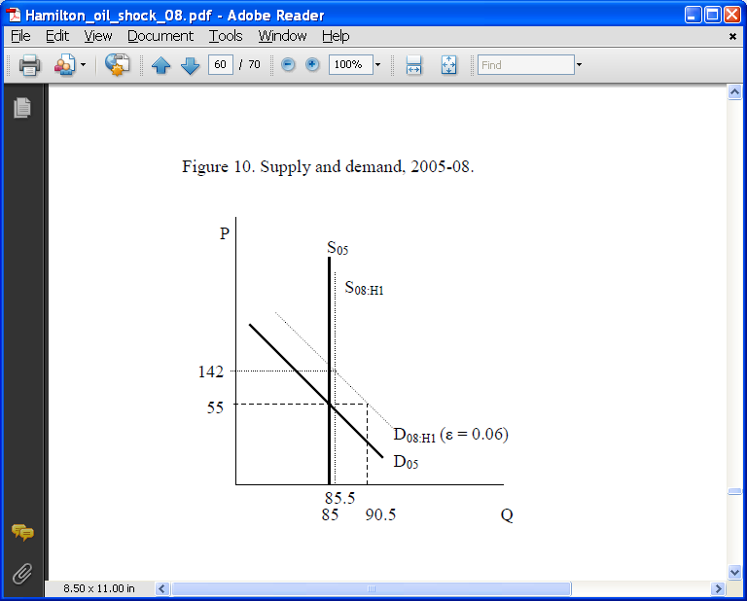
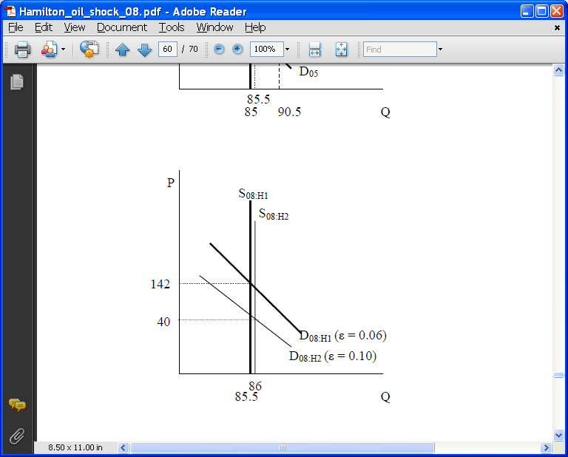
Rising Oil Prices
Oil demand is very inelastic in the short run (~0.06, as shown for the first half of 2008 below), as shown by the economist James Hamilton. It is slightly less inelastic in the longer run as people buy new vehicles, phase out less energy-efficient appliances, etc. (the elasticity for the second half of 2008 came in at 0.10).
James Hamilton has also commented that oil prices exhibit negative convexity in that rising prices hurt the economy more than falling prices help it.
Hamilton has also determined that oil price impact is also dynamic: “oil price increases are much more important than oil price decreases, and increases have significantly less predictive content if they simply correct earlier decreases.”
Notes:
First two bullets come from James Hamilton, “Causes and Consequences of the Oil Shock of 2007-8”, http://www.brookings.edu/economics/bpea/~/media/Files/Programs/ES/BPEA/2009_spring_bpea_papers/2009_spring_bpea_hamilton.pdf
Bullet 1 comes from page 15
Bullet 2 comes from page 24
Last bullet comes from James Hamilton, “What is an Oil Shock?”, which can be downloaded at http://dss.ucsd.edu/~jhamilto/oil.pdf. The quote comes directly from the abstract, and page 3.

Slide 49
Financial Correlations with Oil Prices
Oil Price Changes and the UST 10 Yr
Since 1970, whenever oil prices doubled over a rolling twelve month period, yields in the US 10 Yr Treasury simultaneously climbed almost 63 bps. When oil prices fell, yields typically fell more than 30 bps.
See Appendix P: Doubling Oil Prices and the UST10 Yield
See Appendix Q: Falling Oil Prices and the UST10 Yield
Notes:
UST 10 Yr monthly yields from http://research.stlouisfed.org/fred2/series/GS10/downloaddata?cid=115
WTI Prices from http://www.economagic.com/em-cgi/data.exe/var/west-texas-crude-long

Slide 50
Oil Price Changes and the UST 2-10 Spread
When oil prices doubled over a 12 month period, the yield curve typically flattened 6.4 bps, and overall experienced much more volatility than periods of more moderate oil price changes.
Notes:
UST 10 Yr monthly yields from http://research.stlouisfed.org/fred2/series/GS10/downloaddata?cid=115
UST 2 Yr monthly yields from http://research.stlouisfed.org/fred2/series/GS2/downloaddata?cid=115
WTI Prices from http://www.economagic.com/em-cgi/data.exe/var/west-texas-crude-long

Slide 51
Oil Price Changes and Real Returns on the S&P 500
And when oil prices doubled, real returns on the S&P 500 typically fell 7.7% during the same timeframe, with an average maximum loss of almost 21%.
Notes:
S&P 500 Values from http://ichart.finance.yahoo.com/table.csv?s=%5EGSPC&a=00&b=3&c=1950&d=03&e=11&f=2011&g=m&ignore=.csv
CPI Data from ftp://ftp.bls.gov/pub/special.requests/cpi/cpiai.txt
WTI Prices from http://www.economagic.com/em-cgi/data.exe/var/west-texas-crude-long

Slide 52
Rising Oil Prices and Core CPI
But history might only be a weak guide. While past oil crises caused a spike in core inflation (CPI-U Less Food and Energy), YOY changes in oil prices have not affected inflation since 1990:
Notes:
CPI-U less Food and Energy from http://data.bls.gov/PDQ/servlet/SurveyOutputServlet?data_tool=latest_numbers&series_id=CUSR0000SA0L1E&output_view=pct_1mth
Real Oil Prices from http://www.inflationdata.com/inflation/inflation_rate/historical_oil_prices_table.aspere

Slide 53
Rising Prices and Core CPI
This lack of an impact on core-CPI since 1990 is even more pronounced, given that real oil prices have once again approached 1970s levels:
Notes:
CPI-U less Food and Energy from http://data.bls.gov/PDQ/servlet/SurveyOutputServlet?data_tool=latest_numbers&series_id=CUSR0000SA0L1E&output_view=pct_1mth
Real Oil Prices from http://www.inflationdata.com/inflation/inflation_rate/historical_oil_prices_table.aspere

Slide 54
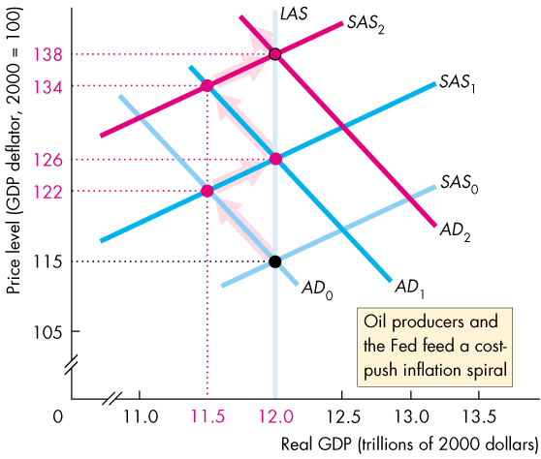
Rising Prices and Core CPI-U
Why have rising oil prices not impacted core CPI-U? Why have rising prices this century not triggered the mass-psychology of cost-push inflation, like they did in the 1970s?
Notes:
Cost-push inflation diagram from Michael Parkin, “Economics”, 8th ed. Pg 694.

Slide 55
Chinese Currency Manipulations
One possible reason for the lack of inflation this past decade has been due to Chinese currency manipulations, which they’ve undertaken in order to keep the cost of their goods low. In other words, China has been paying the “cost-push inflation tax” the US should have been feeling:
Notes:
Historical UST holdings from http://www.treasury.gov/resource-center/data-chart-center/tic/Documents/mfhhis01.txt
Current UST holdings from http://www.treasury.gov/resource-center/data-chart-center/tic/Documents/mfh.txt
Oil prices from http://www.eia.gov/dnav/pet/hist/LeafHandler.ashx?n=PET&s=WTOTUSA&f=W

Slide 56
Chinese Imports v. Oil Imports
While the price of oil has gone up steadily since 2003 and consumed more of our GDP, nonetheless we have been able to enjoy an even greater abundance of cheap Chinese imports during the same timeframe.
Notes:
Import data from http://www.census.gov/foreign-trade/balance/c5700.html
Nominal US GDP data from http://www.bea.gov/national/nipaweb/TableView.asp?SelectedTable=5&ViewSeries=NO&Java=no&Request3Place=N&3Place=N&FromView=YES&Freq=Year&FirstYear=1985&LastYear=2010&3Place=N&Update=Update&JavaBox=no#Mid
Domestic production http://www.eia.gov/dnav/pet/hist/LeafHandler.ashx?n=PET&s=MCRFPUS2&f=A
Imports 1973-2009 http://www.eia.gov/dnav/pet/hist/LeafHandler.ashx?n=pet&s=mttntus2&f=a
Net oil imports is imports minus production (since rising oil prices help domestic producers).
Nominal oil prices from
http://www.inflationdata.com/inflation/inflation_rate/historical_oil_prices_table.asp

Slide 57
US Economic Efficiency
In addition, the US is much more oil efficient now than it used to be. In 2010, the US creates 2.10x more GDP per barrel of oil consumed than in 1949, and 2.43x more than in 1973.
Notes:
Oil consumption 1949-1972 http://www.eia.gov/emeu/aer/overview.html / http://www.eia.gov/emeu/aer/txt/stb0103.xls (note that BTU had to be converted to thousands of bpd using http://www.eia.doe.gov/kids/energy.cfm?page=about_energy_conversion_calculator-basics)
Per capita oil consumption 1973-2010 http://www.eia.gov/dnav/pet/hist/LeafHandler.ashx?n=PET&s=MTTUPUS2&f=A
US GDP http://www.eia.doe.gov/emeu/aer/txt/ptb1601.html

Slide 58
US Economic Efficiency
In 1979 the average American burned 30.02 barrels of oil to create $26,010.66 in real GDP. In 2010, the average American burned 22.65 barrels of oil to create $42,860.56 in real GDP. Real American wealth has been increasing, even as oil consumption has remained flat.
Notes:
Oil consumption 1949-1972 http://www.eia.gov/emeu/aer/overview.html / http://www.eia.gov/emeu/aer/txt/stb0103.xls (note that BTU had to be converted to thousands of bpd using http://www.eia.doe.gov/kids/energy.cfm?page=about_energy_conversion_calculator-basics
Per capita oil consumption 1973-2010 http://www.eia.gov/dnav/pet/hist/LeafHandler.ashx?n=PET&s=MTTUPUS2&f=A
US GDP http://www.eia.gov/totalenergy/data/annual/showtext.cfm?t=ptb1501

Slide 59
Rising Prices and Core CPI-U
Mass psychology of cost-push inflation has not happened yet.
The rising inflation tax of oil has been dampened by an even greater abundance of cheap goods, primarily from China.
The US is much wealthier now than it was in the 1970s, and we are much more efficient in our oil use. The rising price of oil haven’t bothered us as much simply because we’ve been able afford it.

Slide 60
But Will Oil-induced Inflation Remain at Bay?
Oil demand is very inelastic in the short run (~0.06, as shown for the first half of 2008 below), as shown by the economist James Hamilton. It is slightly less inelastic in the longer run as people buy new vehicles, phase out less energy-efficient appliances, etc. (the elasticity for the second half of 2008 came in at 0.10).
James Hamilton has also commented that oil prices exhibit negative convexity in that rising prices hurt the economy more than falling prices help it.
Hamilton has also determined that oil price impact is also dynamic: “oil price increases are much more important than oil price decreases, and increases have significantly less predictive content if they simply correct earlier decreases.”
Notes:
First two bullets come from James Hamilton, “Causes and Consequences of the Oil Shock of 2007-8”, http://www.brookings.edu/economics/bpea/~/media/Files/Programs/ES/BPEA/2009_spring_bpea_papers/2009_spring_bpea_hamilton.pdf
Bullet 1 comes from page 15
Bullet 2 comes from page 24
Last bullet comes from James Hamilton, “What is an Oil Shock?”, which can be downloaded at http://dss.ucsd.edu/~jhamilto/oil.pdf. The quote comes directly from the abstract, and page 3.

Slide 61
But Will Oil-induced Inflation Remain at Bay?
While the US economy is more oil efficient, the general inelasticity of oil, combined with rising prices, forced personal energy expenditures in 2008 to reach their highest levels since the Saudis first initiated netback pricing in 1985:
Oil prices will get high enough again to cause us real economic pain, both in terms of causing recessions, and in terms of triggering cost-push inflation.
Notes:
Personal consumption expenditure data retrieved from:http://www.bea.gov/national/nipaweb/TableView.asp?SelectedTable=74&ViewSeries=NO&Java=no&Request3Place=N&3Place=N&FromView=YES&Freq=Year&FirstYear=1929&LastYear=2009&3Place=N&Update=Update&JavaBox=no#Mid

Slide 62
Will Oil-induced Inflation Remain at Bay?
But Will Oil-induced Inflation Remain at Bay?
Furthermore, if there is strong inflation, is the Federal Reserve really in a position to raise interest rates again, given the significant growth of debt in the US economy since 1980?
In Q3 1980, total debt was 164.48% of GDP. In Q3 2011, after almost 2 full years of painful deleveraging, debt is still 354.56% of GDP.
Notes:
All data from http://www.federalreserve.gov/releases/z1/current/data.htm

Slide 63
Oil and Sector Balances
Per GDP accounting:
Private Net Savings + Government Balance = Current Account Balance
See Appendix R: Deriving Sector Balances
Notes:
Sector balances inspired by http://wallstreetpit.com/8568-the-sector-financial-balances-model-of-aggregate-demand, http://www.nakedcapitalism.com/2010/03/parenteau-on-fiscal-correctness-and-animal-sacrifices-leading-the-piigs-to-slaughter-part-1.html, and http://www.nakedcapitalism.com/2010/03/parenteau-leading-piigs-to-slaughter-part-2.html
Government balance data from http://www.bea.gov/National/nipaweb/TableView.asp?SelectedTable=86&ViewSeries=NO&Java=no&Request3Place=N&3Place=N&FromView=YES&Freq=Year&FirstYear=1960&LastYear=2011&3Place=N&Update=Update&JavaBox=no#Mid
Current account balance data from http://www.bea.gov/National/nipaweb/TableView.asp?SelectedTable=128&ViewSeries=NO&Java=no&Request3Place=N&3Place=N&FromView=YES&Freq=Year&FirstYear=1960&LastYear=2011&3Place=N&Update=Update&JavaBox=no#Mid
Oil prices from http://www.inflationdata.com/inflation/inflation_rate/historical_oil_prices_table.asp

Slide 64
Oil and Sector Balances
Per GDP accounting:
Private Net Savings + Government Balance = Current Account Balance
If the current account balance is dragged down by rising oil prices, either the private sector will have to stop deleveraging its debt, or the government deficit will have to get worse.
Notes:
Sector balances inspired by http://wallstreetpit.com/8568-the-sector-financial-balances-model-of-aggregate-demand, http://www.nakedcapitalism.com/2010/03/parenteau-on-fiscal-correctness-and-animal-sacrifices-leading-the-piigs-to-slaughter-part-1.html, and http://www.nakedcapitalism.com/2010/03/parenteau-leading-piigs-to-slaughter-part-2.html
Government balance data from http://www.bea.gov/National/nipaweb/TableView.asp?SelectedTable=86&ViewSeries=NO&Java=no&Request3Place=N&3Place=N&FromView=YES&Freq=Year&FirstYear=1960&LastYear=2011&3Place=N&Update=Update&JavaBox=no#Mid
Current account balance data from http://www.bea.gov/National/nipaweb/TableView.asp?SelectedTable=128&ViewSeries=NO&Java=no&Request3Place=N&3Place=N&FromView=YES&Freq=Year&FirstYear=1960&LastYear=2011&3Place=N&Update=Update&JavaBox=no#Mid
Oil prices from http://www.inflationdata.com/inflation/inflation_rate/historical_oil_prices_table.asp
Imports 1949-1972 from http://www.eia.gov/emeu/aer/overview.html / http://www.eia.gov/emeu/aer/txt/stb0101.xls (note that BTU had to be converted to thousands of bpd using http://www.eia.doe.gov/kids/energy.cfm?page=about_energy_conversion_calculator-basics)
Imports 1973-2009 http://www.eia.gov/dnav/pet/hist/LeafHandler.ashx?n=pet&s=mttntus2&f=a

Slide 65
Conclusions
Cheap oil transformed the US economy between 1947 and 1973. However, the US now imports between 50 and 60% of the petroleum it consumes.
Rising demand for crude from China, India, and OPEC countries will outstrip the world’s ability supply it, once production reaches a plateau sometime before 2020.
Rising oil prices and unprecedented volatility will be the result.
If the past is any guide, we can likely expect for yields on the 10 Yr UST to rise, for the yield curve to become more volatile, and for the S&P 500 to experience negative real growth in the coming years.
Rising prices will either ignite cost-push inflation, prolong the deleveraging period, or force our public debt to increase.

Slide 66

Thank You!
A HINDOO FABLE. I. IT was six men of Indostan To learning much inclined, Who went to see the Elephant (Though all of them were blind), That each by observation Might satisfy his mind. II. The First approached the Elephant, And happening to fall Against his broad and sturdy side, At once began to bawl: "God bless me!—but the Elephant Is very like a wall!" III. The Second, feeling of the tusk, Cried:"Ho!—what have we here So very round and smooth and sharp? To me 't is mighty clear This wonder of an Elephant Is very like a spear!" IV. The Third approached the animal, And happening to take The squirming trunk within his hands, Thus boldly up and spake: "I see," quoth he, "the Elephant Is very like a snake!"
V. The Fourth reached out his eager hand, And felt about the knee. "What most this wondrous beast is like Is mighty plain," quoth he; "'T is clear enough the Elephant Is very like a tree!" VI. The Fifth, who chanced to touch the ear, Said: "E'en the blindest man Can tell what this resembles most; Deny the fact who can, This marvel of an Elephant Is very like a fan!" VII. The Sixth no sooner had begun About the beast to grope, Than, seizing on the swinging tail That fell within his scope, "I see," quoth he, "the Elephant Is very like a rope!" VIII. And so these men of Indostan Disputed loud and long, Each in his own opinion Exceeding stiff and strong, Though each was partly in the right, And all were in the wrong! MORAL. So, oft in theologic wars The disputants, I ween, Rail on in utter ignorance Of what each other mean, And prate about an Elephant Not one of them has seen! — John Godfrey Saxe, The Blind Men and the Elephant
Notes:
Image of the blind men and the elephant taken from Ganapathy Vidyamurthy “Pairs Trading” pg. ix
Hindoo fable pulled from http://epicureandealmaker.blogspot.com/2011/06/blind-men-and-elephant.html

Slide 67
Epilogue: Oil, Money, and Now What?
The plot, below, encapsulates the original idea behind this presentation. Cheap oil fueled our growth in GDP until 1978, and thereafter we relied on debt to grow our economy. Now that we are deleveraging after the crisis of 2008, and now that oil will never be cheap again, where will our growth come from?
Notes:
Oil consumption 1949-1972 http://www.eia.gov/emeu/aer/overview.html / http://www.eia.gov/emeu/aer/txt/stb0103.xls (note that BTU had to be converted to thousands of bpd using http://www.eia.doe.gov/kids/energy.cfm?page=about_energy_conversion_calculator-basics
Per capita oil consumption 1973-2010 http://www.eia.gov/dnav/pet/hist/LeafHandler.ashx?n=PET&s=MTTUPUS2&f=A
US GDP http://www.eia.doe.gov/emeu/aer/txt/ptb1601.html
Debt levels are taken from the Federal Reserve Flow of Funds (http://www.federalreserve.gov/releases/z1/current/data.htm), GDP information from the BEA (http://www.bea.gov/national/nipaweb/TableView.asp?SelectedTable=6&ViewSeries=NO&Java=no&Request3Place=N&3Place=N&FromView=YES&Freq=Year&FirstYear=1947&LastYear=2010&3Place=N&Update=Update&JavaBox=no#Mid) , and the CPI multipliers from www.usinflationcalculator.com

Slide 68
Appendix A: Oil Statistics
World Energy Production By Source
World Oil Use
Transportation…...64%
Gasoline................26%
Diesel…………......20%
Residual fuel oil.....12%
Jet fuel…………......6%
Notes:
Energy production data from http://www.eia.gov/totalenergy/data/annual/txt/stb1101.xls
Oil use data from Morgan Downey, “Oil 101”, pg. 7

Slide 69
Appendix A: Oil Statistics
Total US Energy Consumption in 2010, across all sectors, was 17.65B barrels of oil equivalent (boe). While the Industrial, Electricity Generation, and Commercial & Residential sectors made heavy use of other fuel types, the 2nd largest sector of consumption, Transportation, is almost entirely dependent on oil:
Transportation
4.94B boe, 28%
Industrial
3.60B boe, 20%
Commercial &
Residential
1.98B boe, 11%
Electricity
Generation
7.13B boe, 40%
Go Back
Notes:
Energy conversions from here http://www.unitjuggler.com/energy-conversion.html
Percentage breakdowns from http://www.eia.gov/totalenergy/data/annual/pecss_diagram.cfm
Inspired by graph on page 11 of Peter Huber and Mark Mills, “The Bottomless Well”

Slide 70
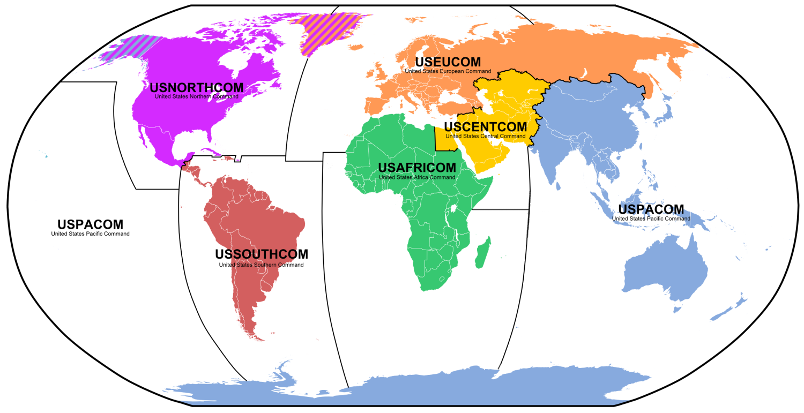
Appendix B: USCENTCOM
The US Central Command (CENTCOM) was established in 1983 to provide military protection for Saudi Arabia. CENTCOM covers 27 countries that contain 65% of the world’s known oil reserves:
Go Back
Notes:
Map from http://upload.wikimedia.org/wikipedia/commons/e/e6/Unified_Combatant_Commands_map.png
Bullet point from Peter Schweizer, “Victory” pg. 180 and from Robert Bryce, “Gusher of Lies”, pg. 98

Slide 71
Appendix C: Oil Price Structure History
Iran-Iraq War Starts
US Financial Crisis Erupts
NYMEX Futures
Launched
Saudi Netback
Pricing Starts
Iraq Invades Kuwait
Arab Oil Embargo
US Oil Production Peaks
US Invades Iraq
China Joins The WTO
Notes:
Oil prices taken from http://www.inflationdata.com/inflation/inflation_rate/historical_oil_prices_table.asp. Historical events taken from http://www.eia.doe.gov/cabs/AOMC/Overview.html

Slide 72
Appendix C: Oil Price Structure History
US Financial Crisis Erupts
Supply Shock #2
Supply Shock #1
Arab Oil Embargo
US Oil Production Peaks
US Invades Iraq
China Joins The WTO
Notes:
Oil prices taken from http://www.inflationdata.com/inflation/inflation_rate/historical_oil_prices_table.asp. Historical events taken from http://www.eia.doe.gov/cabs/AOMC/Overview.html

Slide 73
Appendix C: Oil Price Structure History
Until the early 1980s, most oil was priced by long-term supply contracts.
From the 1950s through the end of the 1960s, oil majors – aka IOCs – negotiated rolling concession agreements with exporting countries.
The majors negotiated with the exporting countries what price they would charge for the oil – its “posted price.” Furthermore, they negotiated what portion of the resulting economic rent they would pay to the countries in the form of a tax or royalty. After much negotiation, the majors and the exporting countries agreed to a 50/50 split of the rent.
Here’s a hypothetical breakdown of price and rents from the 1940s:
In this case above, the oil major would pay a royalty of $0.825 / barrel to the host country.
Posted Price for Oil in the late 1940s |  | 2.50
 | Production Costs | 0.25
 | Transportation | 0.50
 | Built in ROC | 0.10
 | Economic Rent | 1.65
Notes:
Top bullet point from Morgan Downey, “Oil 101”, pg. 318
Example comes from Daniel Yergin, “The Prize”, pg. 414, and from pg. 496

Slide 74
Appendix C: Oil Price Structure History
The “sacred” 50/50 split between IOCs and exporting countries was the root of the post-war petroleum order, and it was maintained from the early 1950s until the early 1970s
In September 1970, Libya, under the newly installed revolutionary government of Muammer al Qaddafi, “squeezed” the small(er) IOC Occidental Petroleum and forced the first 55/45 split of rents.
The Shah of Iran quickly followed suit and negotiated the Tehran Agreement of February 1971, mandating a 55/45 split across OPEC.
Notes:
Libya details come from Daniel Yergin, “The Prize”, pg. 561-2, and from http://www.eia.doe.gov/cabs/AOMC/7079.html
Iran details come from Daniel Yergin, “The Prize”, pg. 564 and from http://www.eia.doe.gov/cabs/AOMC/7079.html

Slide 75
Appendix C: Oil Price Structure History
In November 1970, US oil production peaks. Texas Railroad Commission belatedly goes to 100% allowables in March of 1972
Texas was no longer able to be the world’s swing producer – if the world needed more oil, it had to come from elsewhere, i.e. the Middle East.
America no longer controlled the world’s supply and pricing of oil
In August of 1971, President Nixon ended the dollar’s convertibility to gold, and simultaneously introduced price controls on oil.
Notes:
Texas Railroad details come from Ken Deffeyes, “Hubbert’s Peak” pg. 4, Morgan Downey “Oil 101” pg. 11, and Daniel Yergin “The Prize” pg. 549
US oil production data taken from http://tonto.eia.doe.gov/dnav/pet/hist/LeafHandler.ashx?n=PET&s=MCRFPUS2&f=A
Nixon details come from http://en.wikipedia.org/wiki/Nixon_Shock

Slide 76
Appendix C: Oil Price Structure History
Falling value of the US dollar, plus continued worldwide rising demand in oil, put a huge strain on the posted-price model.
In October 1973, Egypt invaded Israel.
In support of Egypt, the Arab members of OPEC -- Saudi Arabia, Libya, and the four Gulf Arab states stopped supplying oil to the US
Oil supply dropped 5%-10% almost overnight – first great oil shock.
Due to the price controls introduced in 1971, domestic US producers lost money refining oil, resulting in lines at the pumps as gas supplies dwindled.
(During 1967 Six Day War, the US could increase supply to meet world demand, thereby rendering Arab embargo at that time ineffective.)
In December 1973, Iran unilaterally raised posted price to $11.65, a four-fold increase from the mid-1973 posted price of $2.90.
The posted price was eventually raised to $12.70 by the end of 1977.
Notes:
“Falling Value” comes from Daniel Yergin, “The Prize”, pg. 574
“In October 1973” comes from Morgan Downey, “Oil 101” pg. 13, as do the first two sub bullets. The first sub sub bullet comes from Robert Bryce, “Gusher of Lies”, pg. 93-95. The second sub sub bullet comes from Daniel Yergin, “The Prize”, pg. 539
“In December 1973” comes from Daniel Yergin, “The Prize” pg. 607
“The Posted Price” comes from Daniel Yergin, pg. 628

Slide 77
Appendix C: Oil Price Structure History
By 1976 all foreign concessions were nationalized, either by force or negotiation.
Nationalized concessions:
Iran, 1951
Algeria, 1971
Libya, 1973
Iraq, 1975
Purchased concessions:
Kuwait, 1974
Saudi Arabia, 1976
End of the greatest of all concession agreements – final rise of the NOCs.
Saudis finally sign the purchase agreement in 1990!
Notes:
Data comes from http://www.eia.doe.gov/cabs/AOMC/7079.html
Saudi Arabia notes come from Daniel Yergin, “The Prize” pg. 632-4

Slide 78
Appendix C: Oil Price Structure History
Iranian Revolution in 1978 caused virtual cessation of oil exports by Christmas (500K / bpd). Second largest oil supplier in the world “goes dry”. Second great oil shock.
US Hostages taken in November, 1979. All contracts with US oil companies terminated.
November 12: Carter ordered halt to all Iranian imports
November 15: Iran cancelled all contracts with US majors.
Second great oil shock leads to run up in spot prices
By February 1979, spot prices double posted prices
Invoking Force Majeure, exporting countries cancelled contracts with majors, and majors cancelled contracts among themselves.
Majors forced to buy up oil on higher-priced spot market.
Notes:
“Iranian Revolution” from Daniel Yergin, “The Prize” pg. 663. Actual number of bpd from http://www.eia.doe.gov/cabs/AOMC/7079.html
Hostage data taken from http://www.eia.doe.gov/cabs/AOMC/7079.html
Spot price data taken from Daniel Yergin, “The Prize”, pg. 670
Force Majeure taken from Daniel Yergin, “The Prize”, pg. 669-670

Slide 79
Appendix C: Oil Price Structure History
Rise of the spot market:
Spot market heretofore had been a sideshow
Balancing mechanism between long-term supply contracts
Refinery overruns bought at discount, to avoid having to enter into expensive supply contracts.
Represented the true end of the integrated oil companies.
Upstream producing companies were mostly national oil companies, with no downstream refining capabilities
IOCs became contract servicers to NOCs, and downstream refiners.
Trading of contracts between NOC producers and downstream refiners
Arbitragers started taking over term contracts and selling at spot.
Notes:
Spot market notes from Daniel Yergin, “The Prize”, pg. 670
End of integrated oil companies from Daniel Yergin, “The Prize”, pg. 667, and arbitragers pg. 679

Slide 80
Appendix C: Oil Price Structure History
Combination of huge inventory buildup in face of second oil shock, and demand destruction in the face of conservation efforts, led to consumption decline in early 1980s, despite Iran/Iraq war.
Nixon oil price controls, which had been renewed in 1975, ended in 1981.
In the face of falling consumption, Saudi Arabia cut back production in 1983 to prop up OPEC prices.
In 1979, Saudi Arabia exported 1.4 mbpd to the US.
By 1985, Saudi Arabia only exported 26,000 bpd
Kingdom revenues fell from $119B in1981 to $26B in 1985
Notes:
Inventory buildup from Daniel Yergin, “The Prize” pg. 694. Price controls from Judith Stein, “Pivotal Decade”, pg. 214
Demand destruction from Morgan Downey, “Oil 101” pg. 15-6
World oil consumption data from http://www.eia.doe.gov/emeu/aer/txt/ptb1110.html
Saudi Arabia data from Daniel Yergin, “The Prize”, pg. 728

Slide 81
Appendix C: Oil Price Structure History
In March 1983, NYMEX introduced futures contract for WTI crude oil
Standardized contract for delivery to Cushing, Oklahoma
Parallel CBOT futures contract to St. James Parish, Louisiana, ran into delivery problems, leaving the market to NYMEX
In September 1985, Saudi Arabia announced a netback pricing scheme.
Refiners would be guaranteed a profit of $2 / barrel, irrespective of price of oil.
Other OPEC members forced to follow suit.
Spot market / futures market came to dictate the price of oil in netback scheme.
Oil prices collapsed in the third great oil shock.
Go Back
Notes:
NYMEX from Daniel Yergin, “The Prize” pg. 707
Standardized Contract and Parallel CBOT contract from Leah McGrath, “The Asylum”, pg. 91
Netback schemes from Daniel Yergin, “The Prize” pg. 729-30, along with other OPEC members being forced to follow suit
Rise of the spot market to dictate prices comes from “The Prize” pg. 703-4

Slide 82
Appendix D: The Financialization of Oil
On October 18, 1991 the CFTC grants Goldman Sachs subsidiary J. Aron an exemption to the Commodity Exchange Act speculative position limits.
J. Aron recognized as “Bona Fide Hedgers”
“Commission staff granted a bona fide hedge exemption to a swap dealer who was seeking to manage price risk on its books as a result of swaps it planned to enter into with various investors seeking exposure to commodity indexes”
“Swap Dealer Loophole” created
Goldman Sachs Commodity Index (GSCI) launched in 1994, investable via swaps
16 more exemptions granted to other companies in the following years
On August 5, 1994, Uniform Prudent Investor Act for fiduciaries approved and recommended for enactment in the states.
Stresses the need for diversification
“All categoric restrictions on types of investments have been abrogated; the trustee can invest in anything that plays an appropriate role in achieving the risk/return objectives of the trust and that meets the other requirements of prudent investing”
Opens the door for commodities as part of a portfolio
On November 12, 1999, CFTC grants “London Loophole”
The International Petroleum Exchange, based in London, can operate in the US under UK law.
Despite the fact that Greg Mocek, CFTC head of enforcement, couldn’t find a single instance of the UK bringing a case against a commodity trader.
Notes:
Definitions in the CEA can be read at http://ecfr.gpoaccess.gov/cgi/t/text/text-idx?c=ecfr&sid=bb63feb9658d84dadceaa777f9e147fe&rgn=div8&view=text&node=17:1.0.1.1.1.0.2.3&idno=17
J. Aron exemption (and 16 others) from Matt Taibbi, “Griftopia”, pg. 135
“Commission staff…” quote from http://media.mcclatchydc.com/smedia/2010/01/14/17/Hall-_Berkovitz.source.prod_affiliate.91.pdf, pg. 8.
GSCI launching from http://en.wikipedia.org/wiki/Goldman_Sachs
Many of the exemptions and no action letters can be read at http://www.cftc.gov/LawRegulation/CFTCStaffLetters/LettersArchive/index.htm
Uniform Prudent Investor Act from http://www.law.upenn.edu/bll/archives/ulc/fnact99/1990s/upia94.pdf
“London Loophole” letter here: http://www.cftc.gov/ucm/groups/public/@lrlettergeneral/documents/letter/99-69.pdf
Greg Mocek from Leah McGrath Goodman, “The Asylum”, pg. 263

Slide 83
Appendix D: The Financialization of Oil
In May of 2000, Intercontinental Exchange (ICE) founded to compete with NYMEX. Initial ICE backers include Goldman Sachs (14.21%), Morgan Stanley (14.82%), Total (9.43%), BP (8.82%), Societé Generale (8.25%) and others.
ICE was founded to provide an electronic OTC platform
In December of 2000, Commodities Future Modernization Act passed.
Includes “Enron Loophole”, which exempts electronic OTC markets from being regulated
In June of 2001, ICE acquires International Petroleum Exchange
ICE now operates under two CFTC loopholes, the “London Loophole” and “Enron Loophole”
This in addition to the “Swap Dealer Loophole” many of its original investors already had in place.
ICE effectively has no speculative position limits.
On August 8th 2003, CFTC relaxes rule 4.5, its definition of a Commodity Pool Operator (CPO).
Prior to 2003, mutual fund managers:
Could not market participation in the mutual fund as participation in a commodity pool or a vehicle for trading commodities or futures;
Had to represent that commodity futures or options contracts entered into by the fund were for bona fide hedging purposes; and
Had to demonstrate that the aggregate initial margin and/or premiums for non-hedging positions did not exceed 5% of the liquidating value of the fund’s portfolio (after taking into account unrealized profits and losses).
Those significant restrictions were all relaxed.
Notes:
ICE ownership breakdown from http://www.sec.gov/Archives/edgar/data/1174746/000095012305013687/e06540a9sv1za.htm
ICE mission from https://www.theice.com/history.jhtml
CFMA Enron Loophole from http://en.wikipedia.org/wiki/Commodity_Futures_Modernization_Act_of_2000#The_.E2.80.9CEnron_Loophole.E2.80.9D
ICE acquiring IPE from http://www.sec.gov/Archives/edgar/data/1174746/000095012305013687/e06540a9sv1za.htm
CFTC relaxation of rule 4.5 from http://www.cftc.gov/foia/fedreg03/foi030808a.htm
Mutual fund managers from http://www.hedgefundlawblog.com/nfa-petitions-cftc-to-amend-rule-4-5.html

Slide 84
Appendix D: The Financialization of Oil
Collectively these changes have more tightly tied together the OTC with the exchange markets, and have rendered the Swap Dealers as the primary bridge between the two:
OFF EXCHANGE
OTC Derivative Market*
Hedge Funds
Spot oil price, based on differentials to front-month NYMEX WTI
Single commodity swaps, commodity index trackers, structured commodity notes, etc.
Pension Funds
Other Institutional Investors
*In March of 2007, BIS estimated that OTC commodity derivatives had grown from ~$450B in 1998 to ~$6.4T in 2006
Genuinely commercial oil market players
SWAP DEALERS
Front-month NYMEX WTI contract – the global “oil price”
Longest-dated contract
FUTURES CURVE
Co-integration of prices along the length of the curve
ON EXCHANGE
Hedge Funds trading on-exchange as Money-Managers
Floor brokers and traders, market-makers
Notes:
Picture recreated verbatim from Daniel O’Sullivan, “Petromania”, pg. 188

Slide 85
Appendix D: The Financialization of Oil
These changes led to the dramatic growth and restructuring of the oil market over the past 20 years. Commercial users hedging price no longer hold the majority of the long positions in WTI.
On 10/15/1991:
294,441 open contracts on NYMEX
$ 11.6B in 2011 dollars
On 5/17/2011:
1,193,112 open contracts on NYMEX and ICE
$ 115.0B
Oil market grew 891%; real economy grew 67%
WTI Futures Market 10/15/1991
WTI Futures Market 5/17/2011
Other
NYMEX
Unreported
NYMEX
Unreported
ICE
Commercial
NYMEX
Other
ICE
Commercial
NYMEX
Speculator
NYMEX
Other
NYMEX
20%
Money Manager
ICE
32%
Commercial
ICE
48%
Money Manager
NYMEX
Swap Dealer NYMEX
Swap Dealer ICE
Notes:
1991 Historical futures contracts data from http://www.cftc.gov/files/dea/history/deafut_xls_1986_2010.zip
2011 futures contracts data from http://www.cftc.gov/files/dea/history/dea_fut_xls_2011.zip
WTI prices from http://research.stlouisfed.org/fred2/graph/?id=DCOILWTICO,#
Inflation conversion from ftp://ftp.bls.gov/pub/special.requests/cpi/cpiai.txt/

Slide 86
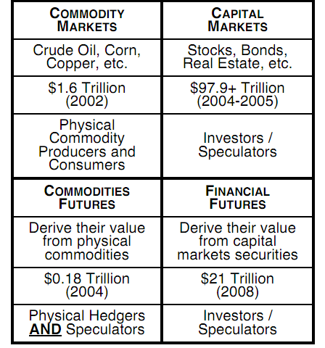
Appendix D: The Financialization of Oil
These decisions by the CFTC in particular were made mostly based on their experience with financial futures. But unlike other capital and commodity markets, which have a homogeneous set of participants, the commodity futures market has a heterogeneous mix of both producers as well as investors / speculators:
In addition to being a commodity, oil has become a financial asset with a store of value.
Notes:
Table from Mike Masters, “Accidental Hunt Brothers”, pg 3. http://www.loe.org/images/content/080919/Act1.pdf
Oil as a commodity and store of value from Kent Moors, “The Vega Factor”, pg. 149

Slide 87
Appendix D: The Financialization of Oil
The increased investment by index funds and other passive investors has led to things like the Goldman Roll, which is the regular roll of front month commodity long positions into farther out futures positions
This has caused oil pricing to move from the previous usual state of backwardation into persistent contango.
Contango has led to trading companies buying storage facilities, shipping companies, and ships themselves.
In the Fall of 2008, the collapse of the oil market resulted in a super-contango. Trading companies sold long dated futures, bought as much near term oil as possible and simply stored it until maturity.
Notes:
First bullet point from http://www.pkverlegerllc.com/PhysicalFinancialMarkets.pdf and from Dan Dicker, “Oil’s Endless Bid” pg. 197
Oil stock data from http://www.eia.gov/dnav/pet/hist/LeafHandler.ashx?n=PET&s=WTTSTUS1&f=W
Weekly WTI prices from http://research.stlouisfed.org/fred2/categories/32357

Slide 88
Appendix D: The Financialization of Oil
In the last 25 years, real oil prices have experienced increasing volatility, particularly since the middle of 2004. This volatility has 1) made hedging a high risk activity for producers and consumers, 2) increased the price for all oil related options, and 3) made it more difficult for the synthetic hedging of project loans of any size.
Notes:
Daily WTI prices from https://research.stlouisfed.org/fred2/series/DCOILWTICO/downloaddata?cid=32356
CPI from ftp://ftp.bls.gov/pub/special.requests/cpi/cpiai.txt

Slide 89
Appendix D: The Financialization of Oil
Additionally, in the last 25 years oil has become more correlated with the stock market. When the stock market goes up, so do oil prices, typically speaking.
Notes:
Weekly WTI prices from http://research.stlouisfed.org/fred2/categories/32357
Weekly S&P 500 Index values from http://finance.yahoo.com/q/hp?s=^GSPC+Historical+Prices

Slide 90
Appendix D: The Financialization of Oil
The oil market has also exhibited “bubble” dynamics similar to the tech bubble of 1999-2000, with roughly equivalent percentage price rises. This is possibly due to the oil market’s mark-to-market accounting / leverage / “New Era (peak oil)” thinking providing positive feedback to “manic” investors.
Notes:
NASDAQ data from http://finance.yahoo.com/q/hp?s=^IXIC&a=00&b=14&c=1999&d=06&e=9&f=2011&g=d
Oil Market data from http://research.stlouisfed.org/fred2/categories/32356
“New Era” thinking from Robert Shiller, “Irrational Exuberance”, pg. 106-131. Also referenced explicitly by Daniel O’Sullivan in “Petromania” pg. 183

Slide 91
Appendix D: The Financialization of Oil
However, with the collapse of Lehman on 9-15-2008, the oil market price behavior diverged dramatically from the previous NASDAQ series, collapsing much more severely. That said, the oil market also made up a lot more of lost ground than did the NASDAQ over a similar period of time.
Lehman Collapse
Notes:
NASDAQ data from http://finance.yahoo.com/q/hp?s=^IXIC&a=00&b=14&c=1999&d=06&e=9&f=2011&g=d
Oil Market data from http://research.stlouisfed.org/fred2/categories/32356

Slide 92
Appendix D: The Financialization of Oil
From the 1960s through the 1980s, the industry was transformed from integrated oil companies (IOCs) to an uneasy coexistence of upstream national oil companies (NOCs), downstream IOCs, transportation and refining companies.
From the 1990s through now, trading and financial companies are beginning to purchase storage and transportation companies. Per Charles Fine’s industry dynamics double helix, the oil industry is beginning to reintegrate, but in a different form.
INTEGRAL PRODUCT
VERTICAL INDUSTRY
PROPRIETARY STANDARDS
MODULAR PRODUCT
HORIZONTAL INDUSTRY
OPEN STANDARDS
NICHE
COMPETITORS
INNOVATION & TECHNICAL ADVANCES
HIGH-
DIMENSIONAL
COMPLEXITY
SUPPLIER
MARKET POWER
ORGANIZATIONAL
RIGIDITIES
PRESSURE TO
DIS-INTEGRATE
INCENTIVE TO
INTEGRATE
PROPRIETARY SYSTEM
PROFITABILITY
Go Back
Notes:
Double helix taken from slide 6 in http://cfp.mit.edu/events/Oct09/CFP%20Fall09%20Presentations/CFP%20plenary%20Fine%20OIPs%20Oct09.ppt

Slide 93
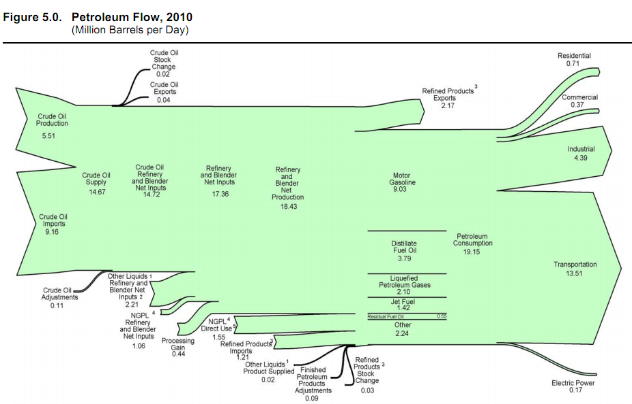
Appendix E: US Petroleum Flows
Go Back
Notes:
Image from http://www.eia.gov/totalenergy/data/annual/pdf/sec5_3.pdf

Slide 94
Appendix F: Lack of New Discoveries
Notes:
Production data from http://www.eia.gov/cfapps/ipdbproject/iedindex3.cfm?tid=5&pid=56&aid=1&cid=regions&syid=1980&eyid=2010&unit=TBPD

Slide 95
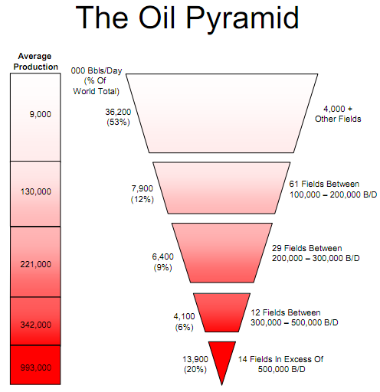
Appendix F: Lack of New Discoveries
Per the late Matt Simmons, a former Texas investment banker, almost 50% of the world’s oil comes from only 116 giant oil fields:
Notes:
Diagram from http://csis.org/files/attachments/040224_simmons.pdf

Slide 96
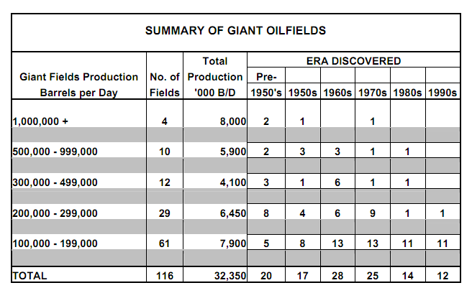
Appendix F: Lack of New Discoveries
Out of these 116 giant oil fields, 90 were discovered before 1980:
Notes:
Table taken from Matt Simmons, “The World’s Giant Oilfields” (http://energy.mazenti.com/files/20060620GiantOilFields.pdf), pg 11

Slide 97
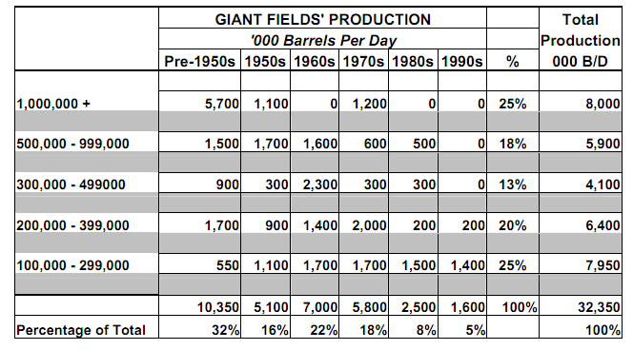
Appendix F: Lack of New Discoveries
As shown by production statistics for the 116 fields, 87% of the oil produced by these giant oilfields comes from those discovered prior to 1980:
Notes:
Table taken from Matt Simmons, “The World’s Giant Oilfields” (http://energy.mazenti.com/files/20060620GiantOilFields.pdf), pg 11

Slide 98
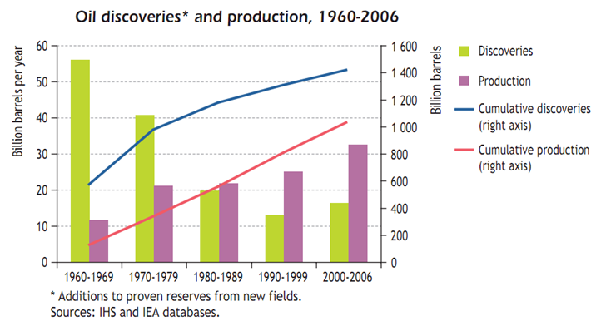
Appendix F: Lack of New Discoveries
As shown by the IEA, the world has been producing (and consuming) more oil in the last 30 years than it has been finding:
Veteran Weeden & Co. oil analyst Charlie Maxwell, as interviewed in Barrons (10/16/2006):
“In 1930 we found 10 billion new barrels of oil in the world and we used 1.5 billion. We reached a peak in 1964 when we found 48 billion barrels and used approximately 12 billion. In 1988, we found 23 billion barrels and used 23 billion barrels. That was the crossover when we started finding less than we were using. In 2005, we found about 5 billion to 6 billion and we used 30 billion. These numbers are just overwhelming.”
Go Back
Notes:
From http://www.iea.org/textbase/nppdf/free/2008/weo2008.pdf, pg 203.
Quote from http://www.oftwominds.com/blogoct06/oil-decline.html. Inspired by Morgan Downey, “Oil 101”, pg. 25

Slide 99
Appendix G: Depletion v. New Supply
In 2008, the IEA did an in-depth analysis of 580 oil fields worldwide and estimated the world’s depletion rate – the percentage of output being lost every year – to be 6.7% per year.
In the same study, the IEA estimated that the natural rate of depletion – the amount being lost absent any investment – is 9.0% per year.
Taking the IEA’s current depletion rate, and taking the Energy Information Administration’s (EIA) crude production rate of 74,051.89 kbpd for 2010, we see:
0.067* 74,051.89 kbpd = 4,961.7 kbpd
Thus every year, the IOCs and NOCs are having to replace ~5 mbpd just to keep current production constant, much less grow output to meet rising demand.
Go Back
Notes:
See http://www.iea.org/textbase/nppdf/free/2008/weo2008.pdf, pg 242-3
EIA data from http://www.eia.gov/cfapps/ipdbproject/IEDIndex3.cfm?tid=5&pid=53&aid=1

Slide 100
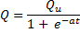
Appendix H: Hubbert’s Peak
Assumptions:
#1 Assumption of Peak Oil – There exists an ultimate, finite amount of oil, Q_{u ,} which makes sense to recover from both an economic (ROI) and energy (EROEI) perspective.
#2 Assumption of Peak Oil – Producers always produce at their maximum allowable rate – that is, they don’t voluntarily limit production.
#3 Assumption of Peak Oil -- As more oil Q is profitably recovered, more capital flows in to spur development, thereby increasing production. Eventually all the “easy to recover” oil has been produced and consumed, and as Q_{u} is approached, production slows as original sources deplete and new sources are not as energy- or cost-effective to recover.
As a result, the cumulative amount of oil recovered up to some point in time t, Q(t), follows an S-curve, which can be modeled by a logistic function.
Q_{u}
0
beginning
end
Notes:
The concept behind this explanation of Peak Oil is taken wholesale from Ken Deffeyes, “Beyond Oil”, pg. 35-51.

Slide 101
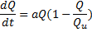
Appendix H: Hubbert’s Peak
If cumulative oil recovered Q does follow those assumptions, then the rate of production – dQ/dt – peaks, as shown below. It essentially peaks when all the “easy to recover” oil has been produced.
The vertical line shows the point of maximum production – that is, the point where the cumulative oil being recovered, Q(t), is changing the fastest over time. The vertical line, above, is the same vertical line as in the previous plot.
Area under the curve is equal to Q_{u}
0
Notes:
The concept behind this explanation of Peak Oil is taken wholesale from Ken Deffeyes, “Beyond Oil”, pg. 35-51.

Slide 102
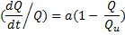
Appendix H: Hubbert’s Peak
If cumulative oil recovery Q does follow a logistic function, then the ultimate recoverable amount, Q_{u}, and the time of peak oil production – that is, when dQ/dt is at its highest point – can be estimated using a line. When percentage production is plotted against the total quantity recovered, it yields a simple line. That is, when dQ/dt (production) is divided by Q (to give a percentage), and plotted against Q, we get the simple line as shown below.
The ultimate quantity, Q_{u}, simply occurs when no more oil can be produced – when the percentage of production is 0. This is highlighted in the plot below.
Peak oil, when dQ/dt is at its maximum, occurs when half the ultimate quantity has been ultimately produced. At that time, the percentage production is half of its initial value.
a
Percentage production is 50% of initial value at peak…
Peak oil happens when half the ultimately recovered oil has been produced…
Ultimate Quantity Recovered
0
Q_{u}
0
Notes:
The concept behind this explanation of Peak Oil is taken wholesale from Ken Deffeyes, “Beyond Oil”, pg. 35-51.

Slide 103
Appendix H: Hubbert’s Peak
Actual US oil production, taken from Energy Information Administration (EIA), is shown below. US production peaked in 1971.
Notes:
The concept behind this explanation of Peak Oil is taken wholesale from Ken Deffeyes, “Beyond Oil”, pg. 35-51.
US oil production data taken from http://tonto.eia.doe.gov/dnav/pet/hist/LeafHandler.ashx?n=PET&s=MCRFPUS2&f=A

Slide 104
Appendix H: Hubbert’s Peak
Taking that US production data, and ignoring the initial points until the trend settles down (in 1930), we have the following graph. The initial points are ignored due to lack of data on total recovered oil prior to the first data point.
The trend line intercepts the Quantity at 217 billion barrels of oil. According to the model, that’s all the oil that will ever be recovered from the US.
Half the percentage production, 0.03204, occurred in 1973. Half the ultimate quantity, 108.5 billion barrels of oil, had been extracted in 1974. Thus, according to the model, the peak US oil production occurred between 1973 and 1974.
Real US production peaked in 1970
SUMMARY OUTPUT
Regression Statistics
Multiple R | 0.984388978
R Square | 0.969021659
Adjusted R Square | 0.968624501
Standard Error | 0.00326133
Observations | 80
ANOVA
 | df | SS | MS | F
Regression | 1 | 0.025951312 | 0.025951 | 2439.888
Residual | 78 | 0.000829629 | 1.06E-05
Total | 79 | 0.026780941
 | Coefficients | Standard Error | t Stat | P-value
Intercept | 0.064080734 | 0.000689073 | 92.99556 | 1.14E-81
X Variable 1 | -0.000295289 | 5.97808E-06 | -49.3952 | 1.3E-60
1974
Half of initial percentage production
1973
108.5
217
Notes:
The concept behind this explanation of Peak Oil is taken wholesale from Ken Deffeyes, “Beyond Oil”, pg. 35-51.
US oil production data taken from http://tonto.eia.doe.gov/dnav/pet/hist/LeafHandler.ashx?n=PET&s=MCRFPUS2&f=A

Slide 105
Appendix H: Hubbert’s Peak
Data for world oil production is not as reliable as data for US production, and EIA only has it starting from 1960.
Notes:
The entire Peak Oil explication is taken wholesale from Ken Deffeyes, “Beyond Oil”, pg. 35-51.
World oil production from 1960 until 1972 taken solely from http://www.eia.doe.gov/emeu/aer/txt/stb1105.xls
World oil production from 1973 until 1979 sum of above data plus NGL data from http://www.eia.doe.gov/emeu/aer/txt/stb1106.xls
In the interest of consistency with the rest of the presentation, world oil production data from 1980 to 2009 taken from http://tonto.eia.doe.gov/cfapps/ipdbproject/iedindex3.cfm?tid=5&pid=53&aid=1&cid=regions&syid=1980&eyid=2010&unit=TBPD

Slide 106
Appendix H: Hubbert’s Peak
Once again, ignoring the initial data until the trend settles down (around 1983), we have the following graph. The initial points were ignored due to lack of information about the total quantity of oil recovered prior to the first data point.
The trend line intercepts the Quantity at 1929 billion barrels of oil (not shown above). According to the model, that’s all the oil that will ultimately be recovered.
Half the percentage production number, 0.03055, occurred in 2006. Half the ultimate quantity, 964.5 billion barrels, had been extracted by 2005. Thus according to the model, world oil production peaked sometime between 2005 and 2006.
SUMMARY OUTPUT
Regression Statistics
Multiple R | 0.968183
R Square | 0.937379
Adjusted R Square | 0.934874
Standard Error | 0.001763
Observations | 27
ANOVA
 | df | SS | MS | F
Regression | 1 | 0.001163 | 0.001163 | 374.2258
Residual | 25 | 7.77E-05 | 3.11E-06
Total | 26 | 0.00124
 | Coefficients | Standard Error | t Stat | P-value
Intercept | 0.061119 | 0.001241 | 49.24312 | 2.04E-26
X Variable 1 | -3.2E-05 | 1.64E-06 | -19.3449 | 1.48E-16
2005
Half of initial percentage production
2006
964.5
Notes:
The entire Peak Oil explication is taken wholesale from Ken Deffeyes, “Beyond Oil”, pg. 35-51.
World oil production from 1960 until 1972 taken solely from http://www.eia.doe.gov/emeu/aer/txt/stb1105.xls
World oil production from 1973 until 1979 sum of above data plus NGL data from http://www.eia.doe.gov/emeu/aer/txt/stb1106.xls
In the interest of consistency with the rest of the presentation, world oil production data from 1980 to 2009 taken from http://tonto.eia.doe.gov/cfapps/ipdbproject/iedindex3.cfm?tid=5&pid=53&aid=1&cid=regions&syid=1980&eyid=2010&unit=TBPD

Slide 107
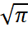
Appendix H: Hubbert’s Peak
M. King Hubbert used a logistic function in all of his analysis. However, a Gaussian (Normal) distribution would have also yielded materially the same results. Below is a typical e^{-x2} Gaussian distribution (LHS), plus its cumulative area (Q(x)) (RHS). Note that the cumulative function follows an S-curve, and it’s ultimate value is the total area under the distribution,
A Gaussian Distribution makes sense due to the Central Limit Theorem. Namely, various oil wells will produce at various rates, but cumulatively, under the Law of Large Numbers, their overall output should follow a Gaussian Distribution.
Notes:
Top bullet point from Ken Deffeyes, “Hubbert’s Peak”, pg. 140

Slide 108
Appendix H: Hubbert’s Peak
Furthermore, the Gaussian Distribution, as a percentage of the cumulative area under the curve, has a form very similar to the real data. Much of the curve is “line-like”, but the initial data falls off steeply like the real US and world production data.
Go Back
Notes:
Graph inspired by rate plot discussion in Ken Deffeyes, “Hubbert’s Peak”, pg. 154

Slide 109
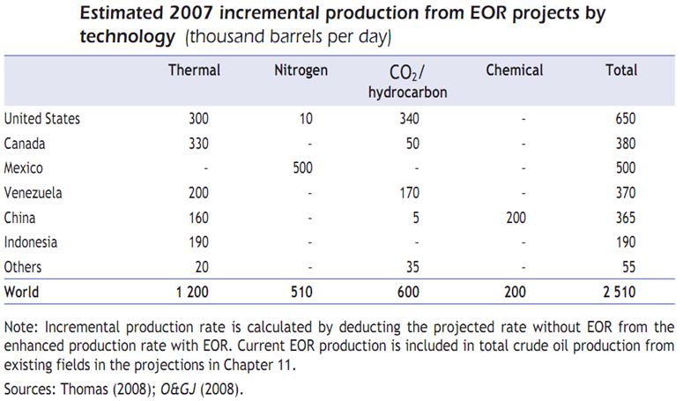
Appendix I: Reserves Growth
Current world recovery factor (RF) – the amount of oil actually recoverable from a typical reservoir – is 35%. Every 1% gain in RF from enhanced oil recovery (EOR) techniques adds ~80B bbl of oil to the world’s reserves. Current EOR technology typically recovers about an additional 10% of oil in place.
Enhanced oil recovery made a non-trivial impact to world output in 2007 – more than 2.5 mbpd production – according to the IEA:
Notes:
First bullet point from http://www.iea.org/textbase/nppdf/free/2008/weo2008.pdf, pg. 211. EOR technology recovering 10% comes from pg 260. Table from pg. 213

Slide 110
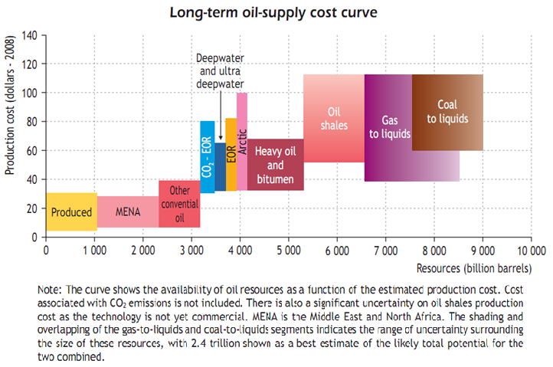
Appendix I: Reserves Growth
As oil prices rise, other sources of oil will be able to add to the world’s reserves:
Go Back
Notes:
From http://www.iea.org/textbase/nppdf/free/2008/weo2008.pdf, pg. 218

Slide 111
Appendix J: Model Problems
Hubbert’s Peak Oil model fails to properly take into account rationed initial production, nor does it take into account enhanced oil recovery techniques.
Rationed initial production pushes out the upward slope of the logistic function.
Enhanced oil recovery (EOR) – such as 3D geosteering, multilateral horizontal well completions / maximum reservoir contact (MRC) wells, steam-assisted gravity drainage (SAGD), CO₂ injection, etc. – pushes out the downward slope.
In addition, the Hubbert technique also suffers from incorrect initial conditions:
The models incorrectly assumed that the production in the first year of data – 1900 for US production data, 1960 for world production data – was all the oil that had ever been produced up until that time
Eventually, as more and more oil was produced relative to the initial years, the percent production trend settled down into something resembling a line
If we had correct data from when oil production first began in 1859, perhaps the models would fit better

Slide 112
Appendix J: Model Problems
It is hard to say when the “Hubbert Linearization” settles down, and that can lead to lines with significantly different implications as you can see for the US data.
Below is the data line that Hubbert would have plotted in 1956. It shows that US oil would peak between 1965 and 1971, with an ultimate recovery of 158.2 B bbl.
1956
158.2
Notes:
This slide inspired by Robert Rapier, http://www.theoildrum.com/node/2357, also inspired by Robin Mills, “The Myth of the Oil Crisis”, pg. 39

Slide 113
Appendix J: Model Problems
It is hard to say when the “linearization” settles down, and that can lead to lines with significantly different implications as you can see for the US data.
In addition to the 1956 line, here is the line that Hubbert would have plotted in 1970 (the year US oil did actually peak). It shows that the US oil would peak between 1970 and 1973, with an ultimate recoverable quantity of 190.67 B bbl.
1956
158.2
190.7
Notes:
This slide inspired by Robert Rapier, http://www.theoildrum.com/node/2357, also inspired by Robin Mills, “The Myth of the Oil Crisis”, pg. 39

Slide 114
Appendix J: Model Problems
It is hard to say when the “linearization” settles down, and that can lead to lines with significantly different implications as you can see for the US data.
In addition to the two previous lines, this shows the line that was drawn previously. It shows the US oil supply peaking in 1973/4, with an ultimately recoverable amount of 217 B bbl.
1956
1970
158.2
190.7
217.0
Notes:
This slide inspired by Robert Rapier, http://www.theoildrum.com/node/2357, also inspired by Robin Mills, “The Myth of the Oil Crisis”, pg. 39

Slide 115
Appendix J: Model Problems
It is hard to say when the “linearization” settles down, and that can lead to lines with significantly different implications as you can see for the US data.
But if you take just the last 30 years of oil data, you get a fourth line. This line shows the US oil supply as having peaked in 1975/6, with an ultimate recovery of 233.0 B bbl.
1956
1970
1979
158.2
190.7
217.0
233.0
Go Back
Notes:
This slide inspired by Robert Rapier, http://www.theoildrum.com/node/2357, also inspired by Robin Mills, “The Myth of the Oil Crisis”, pg. 39

Slide 116
Appendix K: Data Problems
The data used to measure oil production and consumption varies substantially both between and within the publicly available service providers:
According to BP:
“Differences between these world consumption figures and world production statistics are accounted for by stock changes, consumption of non-petroleum additives and substitute fuels, and unavoidable disparities in the definition, measurement or conversion of oil supply and demand data.”
As of 4/28/2011, the EIA will no longer be providing international energy statistics due to budget cuts.
Notes:
BP data from http://www.bp.com/assets/bp_internet/globalbp/globalbp_uk_english/reports_and_publications/statistical_energy_review_2011/STAGING/local_assets/spreadsheets/statistical_review_of_world_energy_full_report_2011.xls
EIA data from http://tonto.eia.doe.gov/cfapps/ipdbproject/iedindex3.cfm?tid=5&pid=53&aid=1&cid=regions&syid=1980&eyid=2010&unit=TBPD and from http://tonto.eia.doe.gov/cfapps/ipdbproject/iedindex3.cfm?tid=5&pid=5&aid=2&cid=regions&syid=1980&eyid=2009&unit=TBPD
BP comment from “Oil Consumption – Barrels” Excel sheet from above link

Slide 117
Appendix K: Data Problems
Most serious data problem of all: OPEC stopped reporting oil production data in 1982.
From 1950 until 1982, oil exporting countries furnished detailed field-by-field oil production data.
Since 1982, OPEC production and reserve data has been sparse and not subject to verification.
“If your country has surplus production capacity today, you are a player in the global oil game. If your wells are currently producing to capacity, you are merely a spectator.”
Swing producers are price-makers; full capacity producers are price-takers.
Official OPEC reserves have more than doubled since 1980, despite the Iran-Iraq war of 1980-8, despite Gulf Wars I and II, and despite the world having consumed ~303B barrels of OPEC oil in the interim.
Notes:
OPEC stopped reporting production data in 1982 from Matt Simmons, “Twilight in the Desert”, pg. 77-9
Reserve data from http://www.bp.com/assets/bp_internet/globalbp/globalbp_uk_english/reports_and_publications/statistical_energy_review_2011/STAGING/local_assets/spreadsheets/statistical_review_of_world_energy_full_report_2011.xls
Spectator quote from Ken Deffeyes, “Hubbert’s Peak”, pg. 149

Slide 118
Appendix K: Data Problems
Most OPEC data is collected from counting and extrapolating tanker traffic, and it’s counted primarily by three firms, Petro-Logistics, Oil Movements, Lloyd’s Intelligence Marine Units
And yet OPEC has provided approximately 40.8% of the world’s oil over the past 5 years, according to the EIA:
Go Back
Notes:
Data collection from Simmons, “Twilight in the Desert” and http://blogs.ft.com/energy-source/2009/05/01/opec-oil-supply-guru-conrad-gerber-has-died/
World oil production data from http://tonto.eia.doe.gov/cfapps/ipdbproject/iedindex3.cfm?tid=5&pid=53&aid=1&cid=regions&syid=1980&eyid=2010&unit=TBPD

Slide 119
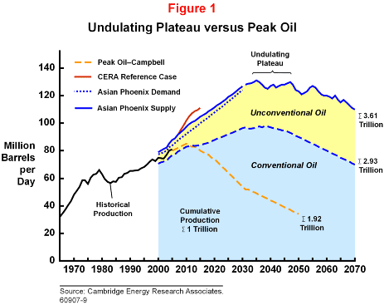
Appendix L: Undulating Plateau?
In my opinion, I think CERA (a famous energy consulting form) is correct in form, if not in numerical substance, with their model of oil production as an undulating plateau.
Go Back
Notes:
Graph taken from http://www.cera.com/aspx/cda/public1/news/pressReleases/pressReleaseDetails.aspx?CID=8444

Slide 120
Appendix M: Why is Oil so Hard to Find?
Presence of oil requires the intersection of 7 low probability events:
Presence of organic-rich sedimentary rock (nutrient trap)
Less than 1% of all sedimentary rocks contain more than 5% carbon
Organic-rich sedimentary rock needs to be buried below the top of the oil window (7500 ft below the surface)
So that the carbon can be cooked – cooking causes the large organic molecules to be cracked into smaller pieces.
Organic-rich sedimentary rock needs to be buried above the bottom of the oil window (15000 ft below the surface)
The carbon can’t be cooked too much – or the molecules become cracked progressively smaller, until they only have one carbon atom, CH₄, or natural gas.
The oil has to be trapped underground in a place not well connected to the surface, such as a dome, fossil reef, or meteor impact site.
Most oil created underground (90%) long ago found its way to the surface via seeps.
The reservoir rock – the rock trapping the oil – has to have sufficient porosity, or pore spaces to trap and hold the oil.
Most reservoir rock is sandstone or limestone (calcium carbonate)
The reservoir rock needs to have sufficient permeability – that is, the pore spaces must be connected to one another so that oil can flow freely.
Oil trapped in low permeability rock is called “tight oil”. Hydraulic fracturing (fracking) techniques are being used more heavily now to retrieve tight oil.
At least one rock layer between the oil reservoir and the surface must have a leak tight seal – like a salt dome.
A billion barrel oil field leaking one drop per second will lose all its oil in 100M years. The middle of the Cretaceous period was 100M years ago, and many oilfields are older than that.
Oil is high density chemical energy that has been distilled from more diffuse forms of biomass energy over millions of years. Its very creation is a statistical anomaly to the Second Law of Thermodynamics, and is therefore something of a geo-historical freak accident.
Notes:
Venn diagram image inspired by Morgan Downey, “Oil 101”, pg 98
Discussion comes from Ken Deffeyes, “Beyond Oil”, pg. 15 and 16
“Tight Oil” comes from Robin Mills, “Myth of the Oil Crisis”, pg. 158

Slide 121
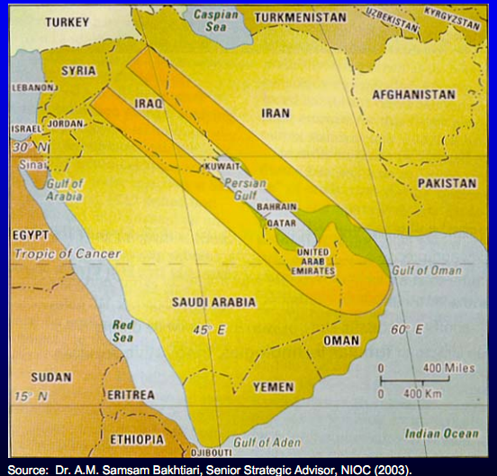
Appendix N: Harbinger of the End
Almost all of the Middle East’s great oil fields fall within a narrow horseshoe
In the 1990s it was discovered that the great reservoir rock underpinning Ghawar, the Arab D formation, did not exist outside the Eastern Province of Saudi Arabia. It had eroded away eons ago.
Notes:
Image from http://csis.org/files/attachments/040224_simmons.pdf
Erosion from Matt Simmons, “Twilight in the Desert” pg. 238

Slide 122
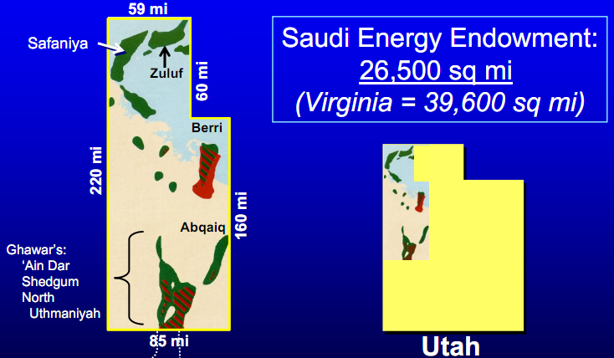
Appendix N: Harbinger of the End
The oil endowment of Saudi Arabia – “The oil in this region is the greatest single prize in all history” – would fit snugly in the NW corner of Utah:
Notes:
Quote from Daniel Yergin, “The Prize”, pg. 375. One of the members of Everett DeGolyer’s team on his exploratory trip to Saudi Arabia in 1943.
Image from http://csis.org/files/attachments/040224_simmons.pdf

Slide 123
Appendix N: Harbinger of the End
In 1997, Oman’s largest oil field, Yibal, reached peak production and began to rapidly deplete.
“Given the technical difficulties involved in [ramping up EOR] production, the contract terms for international oil companies (IOCs) have become more favorable than elsewhere in the region, some allowing significant equity stakes in certain projects.”
EOR techniques such as miscible CO₂ and thermal injection, and used at unprecedented scales, boosted production since 2007.
When Saudi Arabia re-engages with the IOCs on favorable terms for oil development contracts, the endgame for the greatest energy endowment in the world – and the only swing producer left – has probably begun.
Notes:
Production data from http://www.eia.gov/cfapps/ipdbproject/iedindex3.cfm?tid=5&pid=53&aid=1&cid=regions&syid=1981&eyid=2009&unit=TBPD
Quote from http://www.eia.doe.gov/cabs/Oman/Oil.html
Slide inspired by discussion in Robin Mills, “The Myth of the Oil Crisis”, pg. 125

Slide 124
Appendix N: Harbinger of the End
Many oil announcements of great, lasting import have come with relatively little fanfare. Here are a few examples:
In March of 1972, the San Francisco Chronicle had a one sentence item, “The Texas Railroad Commission announced a 100 percent allowable for next month.”
US oil production peaked
In August of 1985, Saudi Arabia announces their netback pricing scheme in a one page article in Time Magazine.
Harbinger of 3rd great oil shock, and ultimate end of the Soviet Union as their major source of hard currency collapses.
On December 11th, 2001, China enters the World Trade Organization.
Trade agreement unleashes the second greatest consumer of oil after the US.
On October 29th, 2009, Saudi Arabia announces that they will no longer use WTI to price their oil. Instead, they will use the Argus Sour Crude Index.
End of America’s hegemony in pricing oil?
Blow to the dollar as the world’s reserve currency?
The peaking and diminishing of the great Saudi oil fields – the world’s last swing producer – will likely be announced in some similarly innocuous-sounding press release.
Go Back
Notes:
First bullet point from Ken Deffeyes, “Hubbert’s Peak”, pg 4.
Second bullet point from Peter Schweizer, “Victory”, pg 237-8.

Slide 125
Appendix O: Plateau Oil Forcing Efficiency
The different OECD nations have significantly different levels of efficiency, in terms of GDP created per barrel of oil.
Go Back
Notes:
Oil from http://tonto.eia.doe.gov/cfapps/ipdbproject/IEDIndex3.cfm?tid=5&pid=54&aid=2
GDP from http://data.worldbank.org/indicator/NY.GDP.MKTP.CD, except Australia, which comes from the avg of the CIA World Factbook estimate and the IMF estimate, as found on http://en.wikipedia.org/wiki/List_of_countries_by_GDP_(nominal), and New Zealand, which comes from http://www.imf.org/external/pubs/ft/weo/2010/01/weodata/weorept.aspx?sy=2007&ey=2010&scsm=1&ssd=1&sort=country&ds=.&br=1&c=196&s=NGDPD%2CNGDPDPC%2CPPPGDP%2CPPPPC%2CLP&grp=0&a=&pr.x=34&pr.y=2

Slide 126
Appendix P: Doubling Oil Prices and the UST10 Yield
From 1/1970 through 9/2011, there were 24 twelve-month rolling timeframes during which oil prices doubled. What happened to the yield on the UST10 during those periods of doubling?
For example, between 11/1/1978 and 11/1/1979, the price of WTI grew 108.75%.
As shown below, in that timeframe the min, max, and avg change in the yield of the US 10 Yr Treasury turn was 10, 184, and 51.75 bps, respectively.
Date | WTI | US 10 YR |  | Change (bps)
11/1/1978 | 14.85 | 8.81 |  | --
12/1/1978 | 14.85 | 9.01 |  | 20
1/1/1979 | 14.85 | 9.10 |  | 29
2/1/1979 | 15.85 | 9.10 |  | 29
3/1/1979 | 15.85 | 9.12 |  | 31
4/1/1979 | 15.85 | 9.18 |  | 37
5/1/1979 | 18.1 | 9.25 |  | 44
6/1/1979 | 19.1 | 8.91 |  | 10
7/1/1979 | 21.75 | 8.95 |  | 14
8/1/1979 | 26.5 | 9.03 |  | 22
9/1/1979 | 28.5 | 9.33 |  | 52
10/1/1979 | 29 | 10.30 |  | 149
11/1/1979 | 31 | 10.65 |  | 184
WTI Y/Y | 108.75 |  | Avg | 51.75
Minimum
Maximum
Average
Notes:
UST 10 Yr monthly yields from http://research.stlouisfed.org/fred2/series/GS10/downloaddata?cid=115
WTI Prices from http://www.economagic.com/em-cgi/data.exe/var/west-texas-crude-long

Slide 127
Appendix P: Doubling Oil Prices and the UST10 Yield
This is the distribution of the minimum changes in yield during those 24 timeframes:
Avg Min: -8.33
Notes:
UST 10 Yr monthly yields from http://research.stlouisfed.org/fred2/series/GS10/downloaddata?cid=115
WTI Prices from http://www.economagic.com/em-cgi/data.exe/var/west-texas-crude-long

Slide 128
Appendix P: Doubling Oil Prices and the UST10 Yield
This is the distribution of both the minimum and the average changes in yield for those 24 instances:
Avg Min: -8.33
Avg: 62.92
Notes:
UST 10 Yr monthly yields from http://research.stlouisfed.org/fred2/series/GS10/downloaddata?cid=115
WTI Prices from http://www.economagic.com/em-cgi/data.exe/var/west-texas-crude-long

Slide 129
Appendix P: Doubling Oil Prices and the UST10 Yield
And this is the distribution of the minimum, average, and maximum changes in yield for those 24 instances:
Avg Min: -8.33
Avg: 62.92
Avg Max: 168.58
Go Back
Notes:
UST 10 Yr monthly yields from http://research.stlouisfed.org/fred2/series/GS10/downloaddata?cid=115
WTI Prices from http://www.economagic.com/em-cgi/data.exe/var/west-texas-crude-long

Slide 130
Appendix Q: Falling Oil Prices and the UST10 Yield
As an example, what happens to the yield of the US 10 Yr Treasury when the price of oil falls over 12 months?
Between 4/1/1980 and 4/1/1981, the price of WTI fell 3.8%
As shown below, in that timeframe the min, max, and avg change in the yield of the US 10 Yr Treasury turn was 169, 221, and 41.75 bps, respectively.
In addition to 4/1/1980 through 4/1/1981, there were another 175 instances of rolling12 month windows where WTI oil prices fell.
Date | WTI | US 10 YR |  | Change (bps)
4/1/1980 | 39.5 | 11.47 |  | --
5/1/1980 | 39.5 | 10.18 |  | -129
6/1/1980 | 39.5 | 9.78 |  | -169
7/1/1980 | 39.5 | 10.25 |  | -122
8/1/1980 | 38 | 11.1 |  | -37
9/1/1980 | 36 | 11.51 |  | 4
10/1/1980 | 36 | 11.75 |  | 28
11/1/1980 | 36 | 12.68 |  | 121
12/1/1980 | 37 | 12.84 |  | 137
1/1/1981 | 38 | 12.57 |  | 110
2/1/1981 | 38 | 13.19 |  | 172
3/1/1981 | 38 | 13.12 |  | 165
4/1/1981 | 38 | 13.68 |  | 221
WTI Y/Y % | -3.80 |  | Avg | 41.75
Minimum
Maximum
Average
Notes:
UST 10 Yr monthly yields from http://research.stlouisfed.org/fred2/series/GS10/downloaddata?cid=115
WTI Prices from http://www.economagic.com/em-cgi/data.exe/var/west-texas-crude-long

Slide 131
Appendix Q: Falling Oil Prices and the UST10 Yield
This is the distribution of the minimum changes in yield for those 176 instances:
Avg Min: -111.04
Notes:
UST 10 Yr monthly yields from http://research.stlouisfed.org/fred2/series/GS10/downloaddata?cid=115
WTI Prices from http://www.economagic.com/em-cgi/data.exe/var/west-texas-crude-long

Slide 132
Appendix Q: Falling Oil Prices and the UST10 Yield
This is the distribution of both the minimum and the average changes in yield for those 176 instances:
Avg Min: -111.04
Avg: -30.32
Notes:
UST 10 Yr monthly yields from http://research.stlouisfed.org/fred2/series/GS10/downloaddata?cid=115
WTI Prices from http://www.economagic.com/em-cgi/data.exe/var/west-texas-crude-long

Slide 133
Appendix Q: Falling Oil Prices and the UST10 Yield
And this is the distribution of the minimum, average, and maximum changes in yield for those 176 instances:
Avg Min: -111.04
Avg: -30.32
Avg Max: +53.33
Go Back
Notes:
UST 10 Yr monthly yields from http://research.stlouisfed.org/fred2/series/GS10/downloaddata?cid=115
WTI Prices from http://www.economagic.com/em-cgi/data.exe/var/west-texas-crude-long

Slide 134
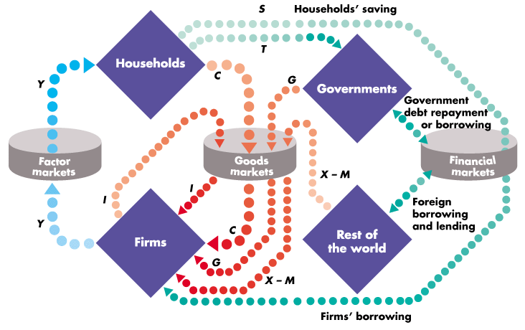
Appendix R: Deriving Sector Balances
From the diagram, flows into the factor market represent GDP:
y = Consumption + Investment + Government Spending + eXports - iMports
Notes:
GDP diagram from Michael Parkin, “Economics”, 8th ed. Pg 485.
Explanation similar to Rob Parenteau, slide 7, in http://www.levyinstitute.org/conferences/minsky2011/presentations/Parenteau.pdf

Slide 135
Appendix R: Deriving Sector Balances
As do flows out of the factor market:
y = Consumption + Savings + Taxes
Notes:
GDP diagram from Michael Parkin, “Economics”, 8th ed. Pg 485.
Explanation similar to Rob Parenteau, slide 7, in http://www.levyinstitute.org/conferences/minsky2011/presentations/Parenteau.pdf

Slide 136
Appendix R: Deriving Sector Balances
Putting them together:
y = Consumption + Investment + Government Spending + eXports - iMports
y = Consumption + Savings + Taxes
Thus :
Consumption + Savings + Taxes = Consumption + Investment + Government Spending + eXports – iMports
And:
(Savings – Investment) + (Taxes - Government Spending) = (eXports – iMports)
Private Net Savings + Government Balance = Current Account Balance
Go Back
Notes:
GDP diagram from Michael Parkin, “Economics”, 8th ed. Pg 485.
Explanation similar to Rob Parenteau, slide 7, in http://www.levyinstitute.org/conferences/minsky2011/presentations/Parenteau.pdf

Slide 137
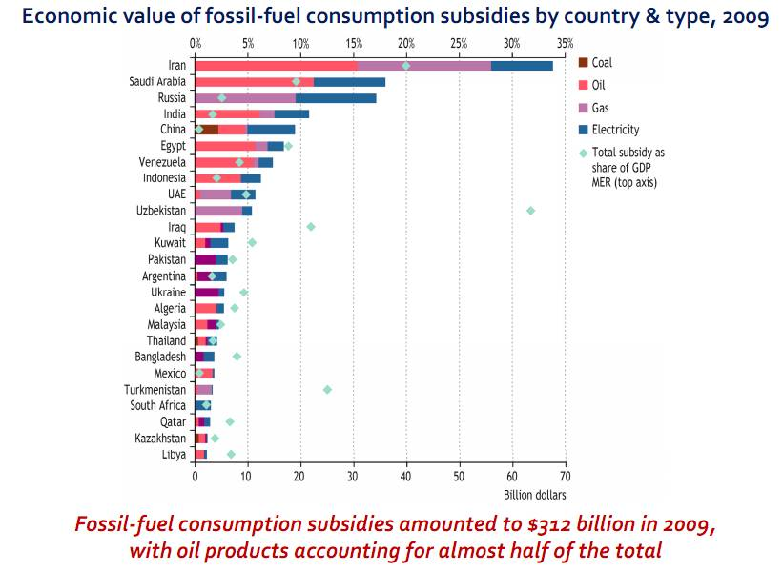
Appendix S: Oil Subsidies
According to the International Energy Agency (IEA), energy subsidies are distorting price signals:
Notes:
First graph in http://www.worldenergyoutlook.org/docs/weo2010/key_graphs.pdf

Slide 138
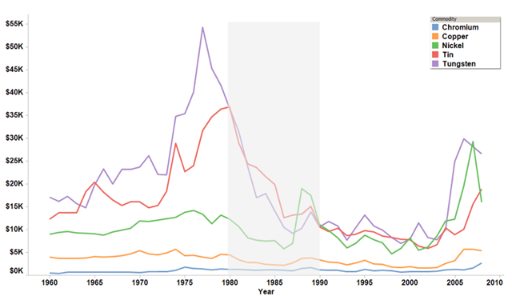
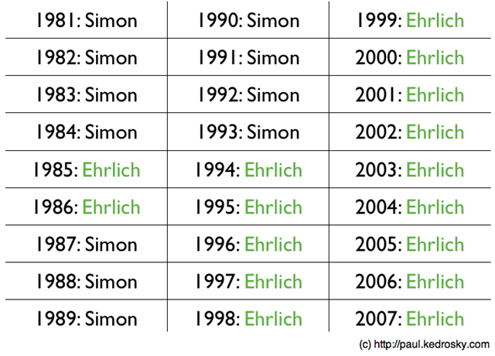
Appendix T: The Ehrlich / Simon Wager
The famous Ehrlich Simon resource wager depended heavily on initial prices. If the bet had been taken at different timeframes, Julian Simon might not have won:
Notes:
Graphs and discussion from http://paul.kedrosky.com/archives/2010/02/re-litigating_t.html

Slide 139
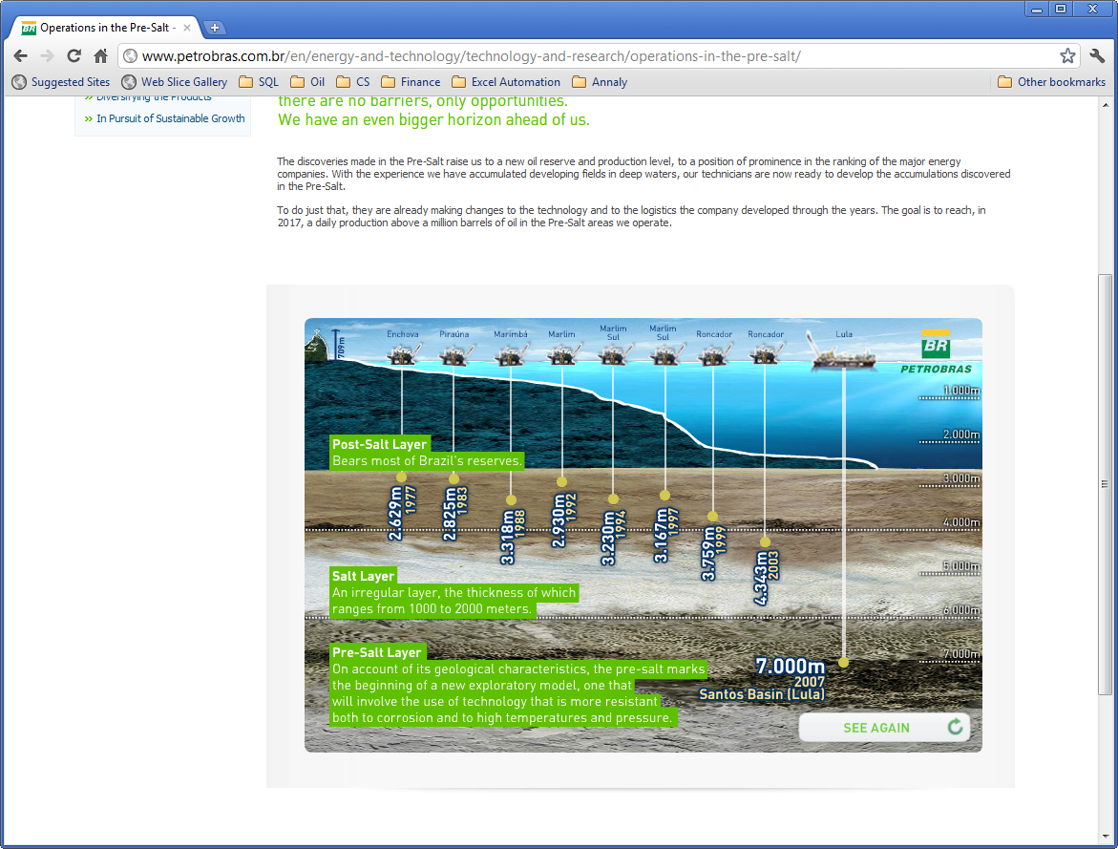
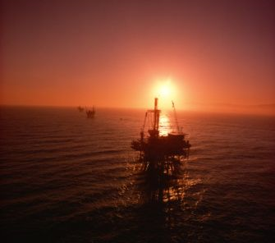
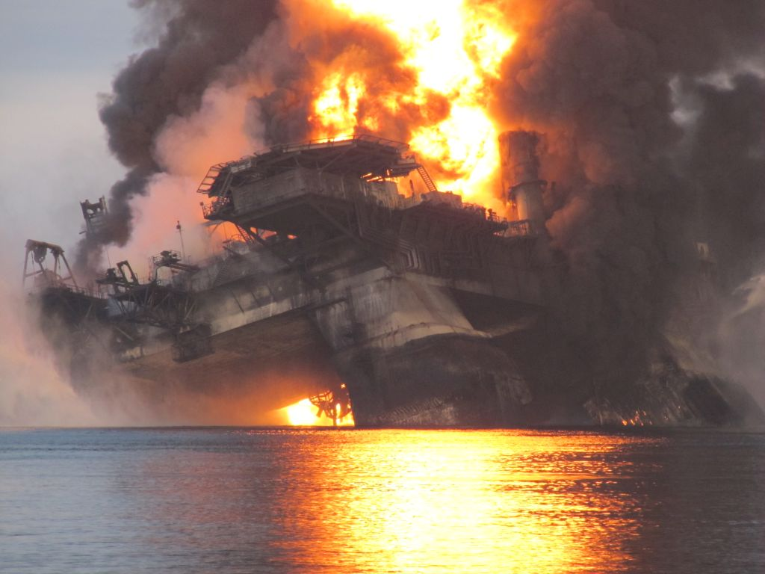
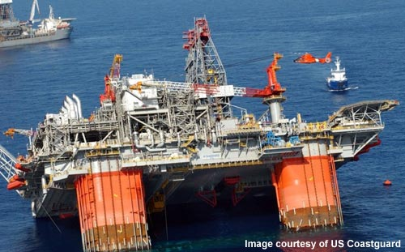
Appendix U: Deepwater
Notes:
Petrobras from http://www.petrobras.com.br/en/energy-and-technology/technology-and-research/operations-in-the-pre-salt/
Deepwater Horizon from http://www.doobybrain.com/2010/05/04/photos-of-the-deepwater-horizon-oil-drilling-rig-on-fire/
Thunderhorse listing from http://www.offshore-technology.com/projects/north-america_gallery.html
Oil rigs from http://www.jupiterimages.com/Image/royaltyFree/87758708#Header

Slide 140
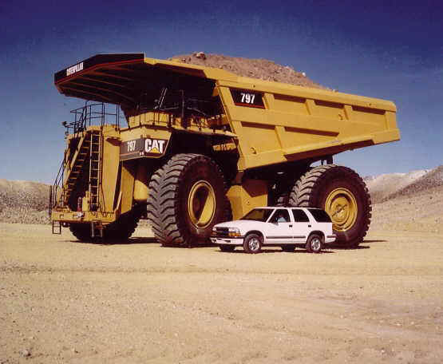
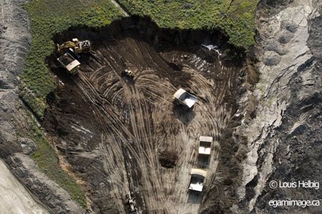
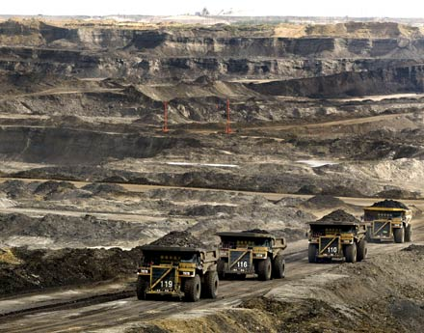
Appendix V: Canadian Tar Sands
According to the IEA, production from Canadian oil sands is projected to increase from 1.2 mb/d in 2007 to 5.9 mb/d in 2030.
Total proven recoverable oil-sands reserves are estimated at 175 billion barrels, of which 35 billion barrels can be mined and 140 billion barrels can be produced in situ.
Estimates are highly uncertain due to environmental issues, notably water use and CO₂ emissions
Notes:
Right image from http://www.beautifuldestruction.ca/bdexhibitiongall.html
Bottom image from http://priceofoil.org/2010/09/28/dirty-black-can%E2%80%99t-ever-be-virgin-white/
Bullet points from http://www.iea.org/textbase/nppdf/free/2008/weo2008.pdf, pg. 262

Slide 141
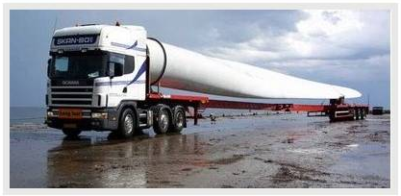
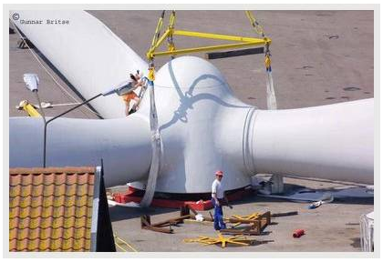
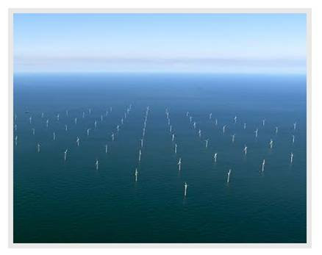
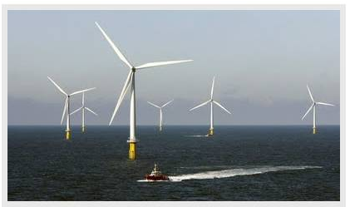
Appendix W: Roots of Danish Efficiency?
Notes:
Photos of Horns Rev, the biggest windfarm in the world, http://amazepicsvids.blogspot.com/2009/10/horns-rev-biggest-wind-farm-in-world.html

Slide 142
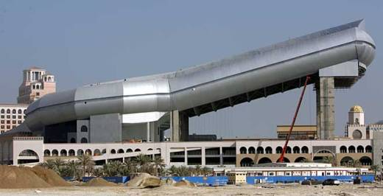

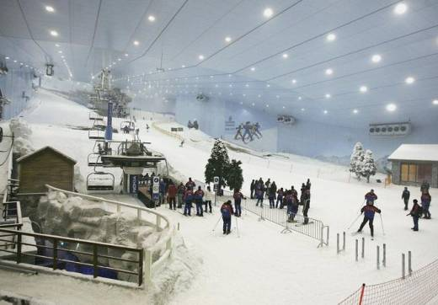

Appendix X: Ski Dubai
Notes:
All images from http://www.mountainyahoos.com/SkiResorts/Dubai.html

Slide 143


Appendix Y: 87,000,000 Barrels
At peak flow rate, it takes more than 81 minutes for 87,000,000 barrels of water to tumble over the crest of the combined American and Canadian Niagara Falls.
American Falls
Canadian
Horseshoe Falls
Notes:
Image from http://openwalls.com/image/7632/niagara_falls_ontario_canada_1280x720.jpg
http://www.myniagarafallsonline.com/wp-content/uploads/13_5_orig.jpg
Data from http://www.niagaraparks.com/media/geology-facts-figures.html

Slide 144
References
Books
Gusher of Lies, Robert Bryce
Beyond Oil, Ken Deffeyes
Hubbert’s Peak, Ken Deffeyes
Oil’s Endless Bid, Dan Dicker
Oil 101, Morgan Downey
The Asylum, Leah McGrath Goodman
The Bottomless Well, Peter Huber and Mark Mills
World Energy Outlook 2008, IEA
Oil Factor, Stephen Leeb
The Coming Economic Collapse, Stephen Leeb
Game Over, Stephen Leeb
The Doomsday Myth, Charles Maurice
Myth of the Oil Crisis, Robin Mills
The Vega Factor, Kent Moors
Petromania, Daniel O’Sullivan
The Oil Card, James Norman
Why Your World is About to Get a Whole Lot Smaller, Jeff Rubin
Twilight in the Desert, Matthew Simmons
The Hidden Hand of American Hegemony, David Spiro
The Prize, Daniel Yergin,
The Quest, Daniel Yergin
Others as referenced in the notes
Websites
US Energy Information Administration
InflationData.com
World Data Bank
Matt Simmons Speeches / Papers
The Oil Drum
Peak Oil Debunked
Jeff Rubin’s Smaller World
Oil and Energy Investor
Others as referenced in the notes

Slide 145
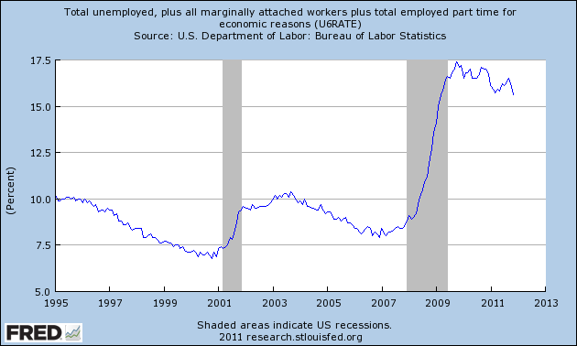




Slide 146




